Slide 1
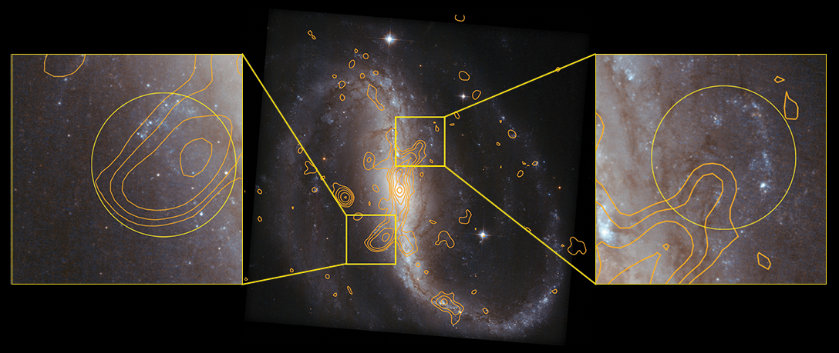
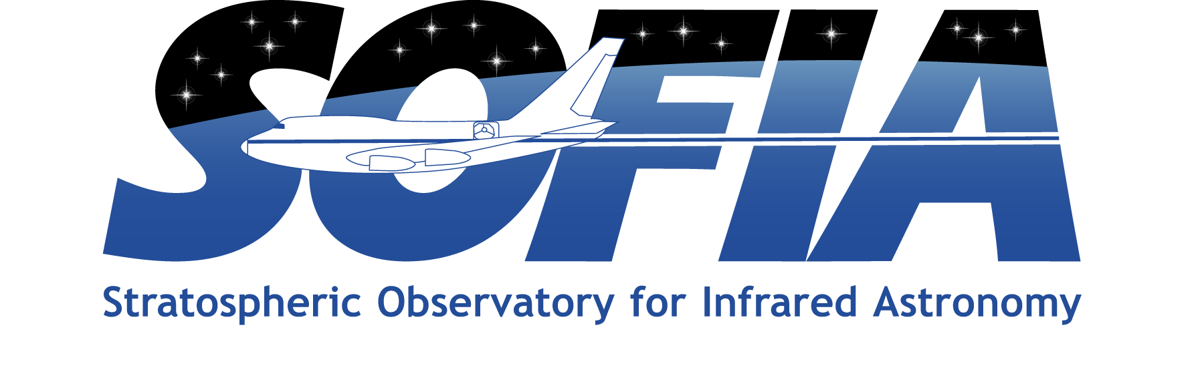

Evidence of [CII] Shocked Emission in NGC 7479
Paper: “[C II] and CO Emission along the Bar and Counter-arms of NGC 7479”
Fadda, Dario, et al., 2021/03, ApJ, 909, 204.
Image credit: ESA/Hubble & NASA
SOFIA/FIFI-LS observed the entire bar and counter-arm structure of NGC 7479 to study the distribution and intensity of the [CII] line at 157.7µm. This is the first complete [CII] observation of a galaxy bar ever done. The SOFIA study concludes that most of the [CII] emission comes from the molecular gas along the bar. However, the emission from the ends of the counter-arm structure is more complex.
Infrared diagnostics show that the [CII] emission is compatible with star formation in the northern region (right panel) but much more intense than expected from star formation in the southern region (left panel). This excess [CII] emission probably originates in warm shocked molecular gas heated by the interaction of the radio jet forming the counter-arms with the interstellar medium in the galaxy.
Notes:
Paper DOI: http://doi.org/10.3847/1538-4357/abe0b8
High-res image link: https://www.sofia.usra.edu/sites/default/files/2021-12/SCI2021_0027.png
Science Spotlight: https://www.sofia.usra.edu/publications/science-results-archive/evidence-cii-shocked-emission-ngc-7479

Slide 2
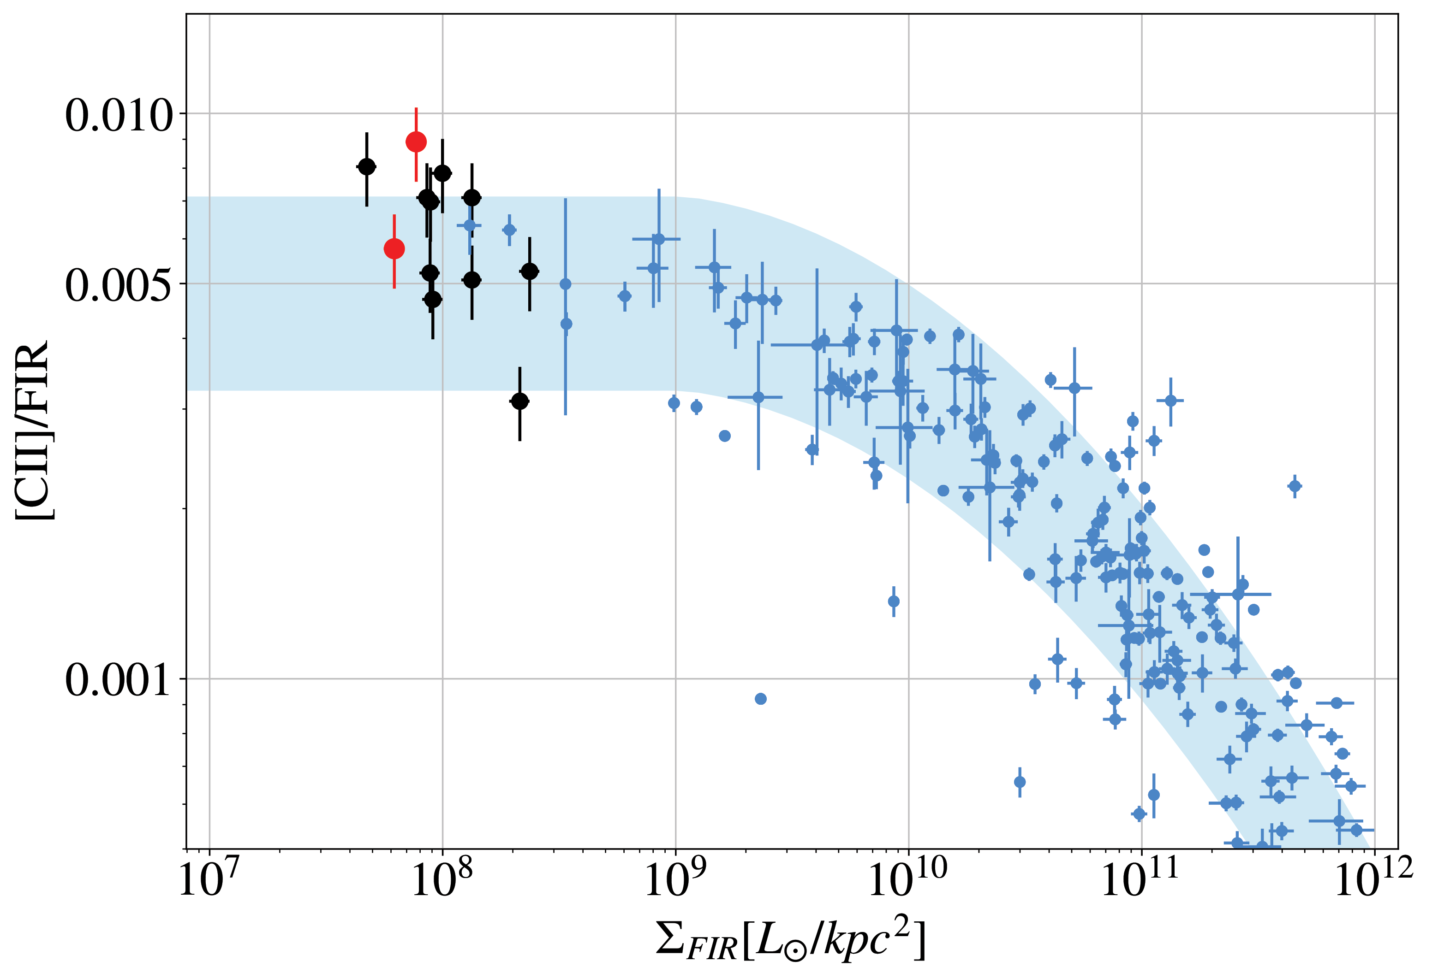
Evidence of [CII] Shocked Emission in NGC 7479
Ratios of [C II] over far-IR emission as a function of the infrared surface brightness. The blue symbols depict observations from a comparison sample (Diaz–Santos et al. 2017) and the shaded band is the fitted curve with 1-σ uncertainty showing the zone where the [C II] emission is compatible with star formation. The black and red symbols represent the data for the northern and southern counter-arm regions, respectively.
Image credit: Fadda et al. 2021
Notes:
High-res image link: https://www.sofia.usra.edu/sites/default/files/2021-12/SCI2021_0026.png

