Slide 1
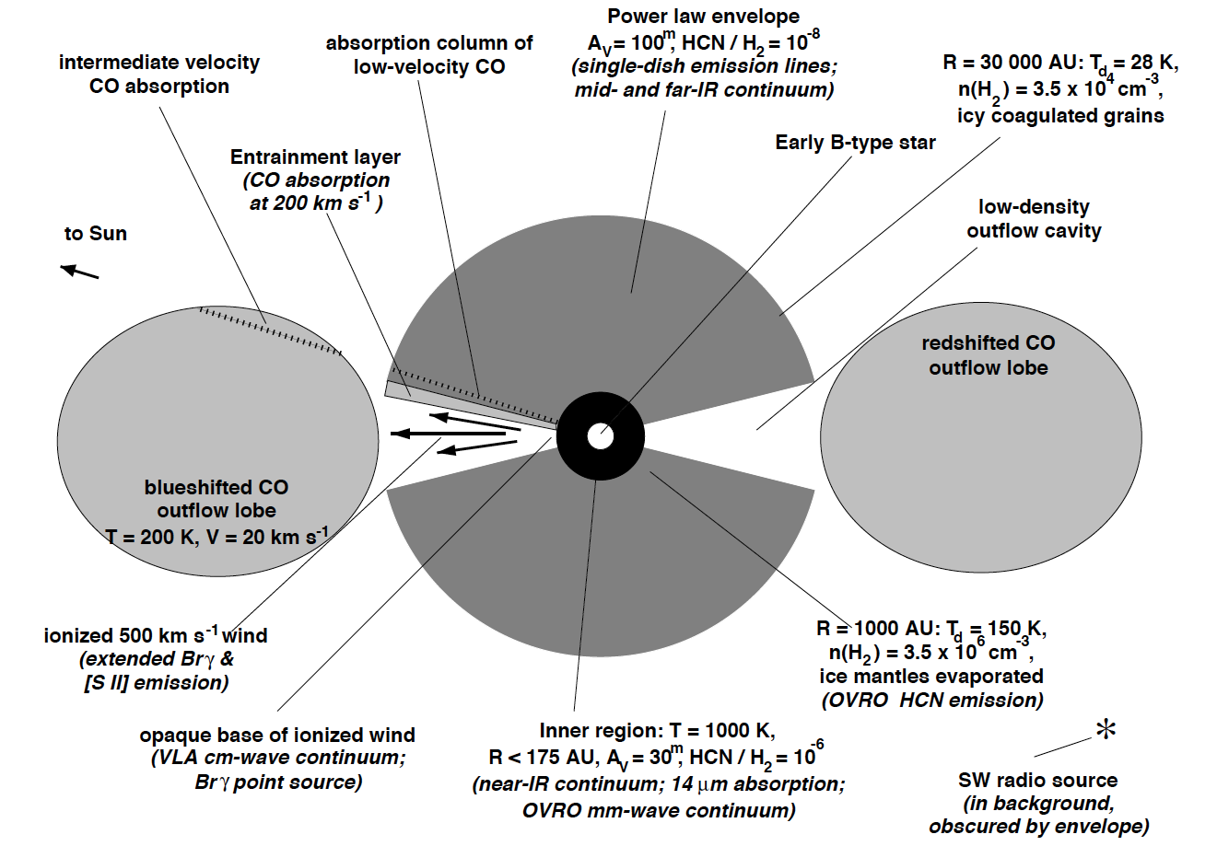
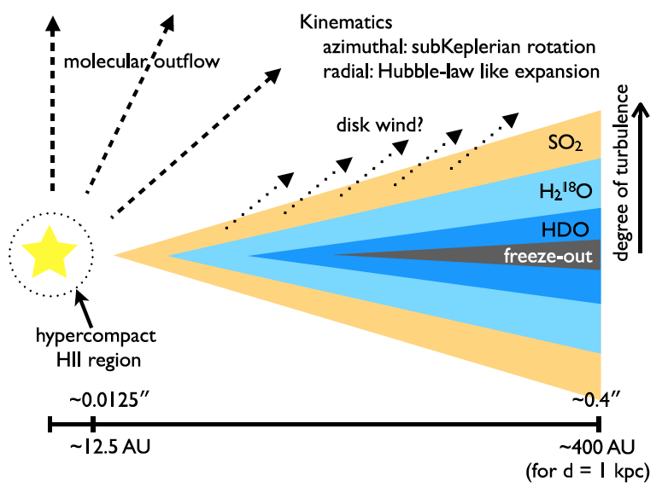
Detection of H₂O Vapor in AFGL 2591
Observations of Water Absorption in the Protostar AFGL 2591 at High Spectral Resolution
Indriolo et al. 2015, ApJL, 802, L14
Instrument: EXES
Previous observations of AFGL 2591 have given no indication of where the H₂O features originate.
EXES observations with a resolution of R = 86,000 were able to detect and measure the v₂ 1_{1,1}-0_{0,0} ground state transition of para-H₂O at 6.1163311 µm.
Background
Velocity resolved structure of H₂O absorption lines provides transition level-specific column densities & information on the dynamics of the H₂O-bearing environment.
Protostars are dynamic systems with complex structure, including accretion disk, envelope, jets, winds, & shocks.
Floris et al., 1999, ApJ, 522, 991
Wang et al., 2012, A&A, 543, A22
Background image credit: C. Aspin et al., NIRI, Gemini Obs., NSF

Slide 2
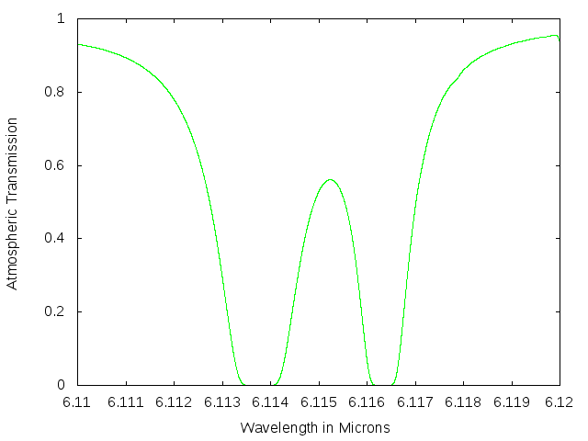
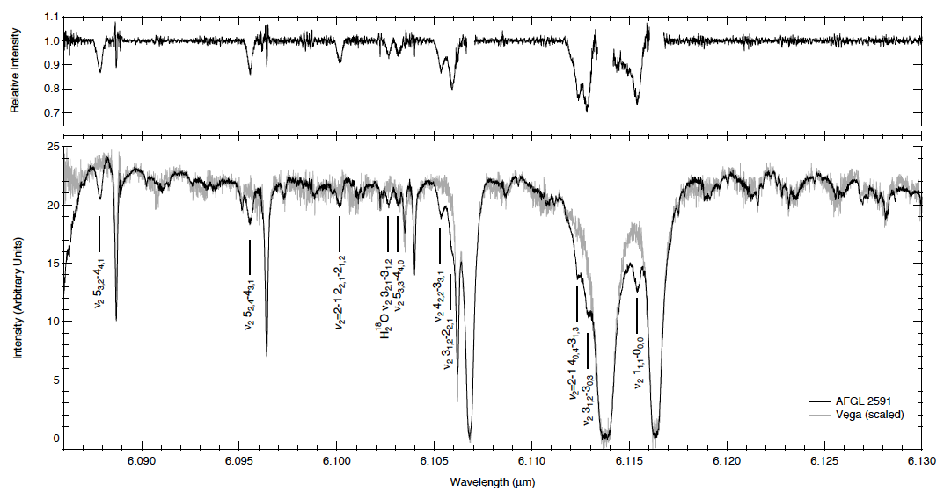
Detection of H₂O Vapor in AFGL 2591
Absorption features detected from ro-vibrational transitions of H₂O, including seven from v₂-band, two from vibrationally excited v₂-band, and one from v₂-band of H₂¹⁸O
One of the absorption features is of the v₂ 1_{1,1}-0_{0,0} transition at 6.1163311 µm, which probes the ground state of para-H₂O
Relative strengths of features suggests a covering fraction of f ≥ 0.25, which leads to column densities of N(H₂O) – (1.3 ± 0.3) x 10¹⁹ cm⁻² at T = 640 ± 80 K
V=-34.7 km/s
Telluric
&
para-H20
ground state
Left: Line profiles indicate origination in the dense, hot region at the base of the outflow.
EXES observations provide unique insights into the structure of the protostars such as AFGL 2591
AFGL 2591
Above: The rest wavelength of the targeted transition lies directly in an atmospheric absorption feature. Using ATRAN, SOFIA can take advantage of the Earth’s motion to Doppler shift the line out of the telluric feature--estimating the atmospheric telluric absorption at stratospheric altitudes.
atmosphere
Background image credit: C. Aspin et al., NIRI, Gemini Obs., NSF

