Slide 1
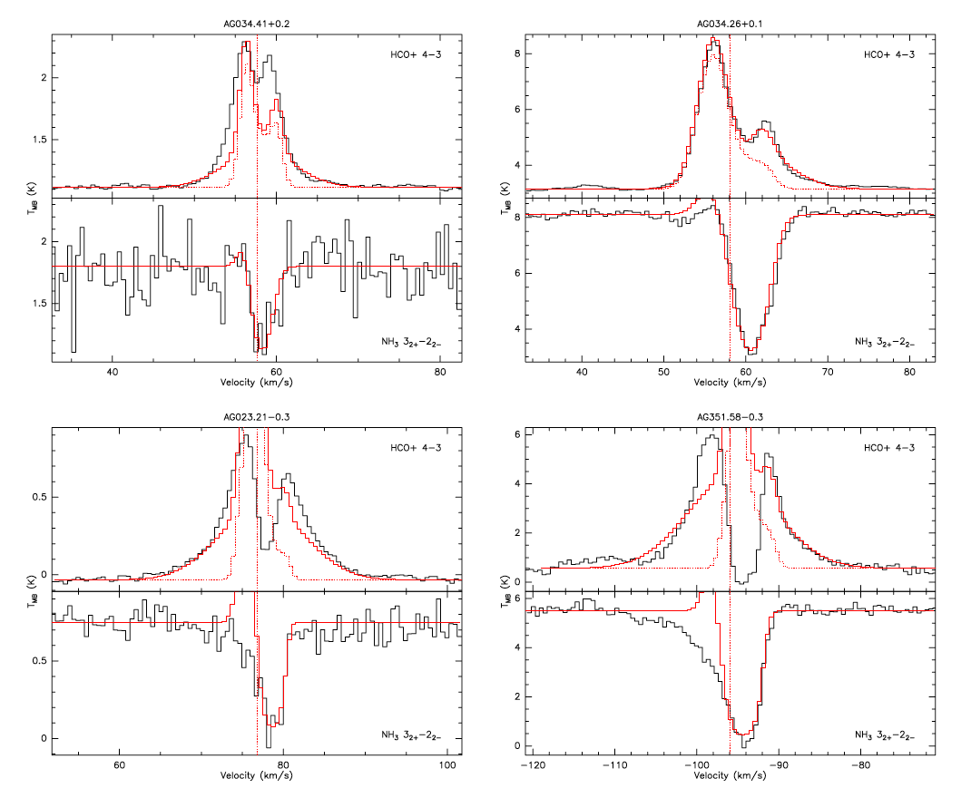
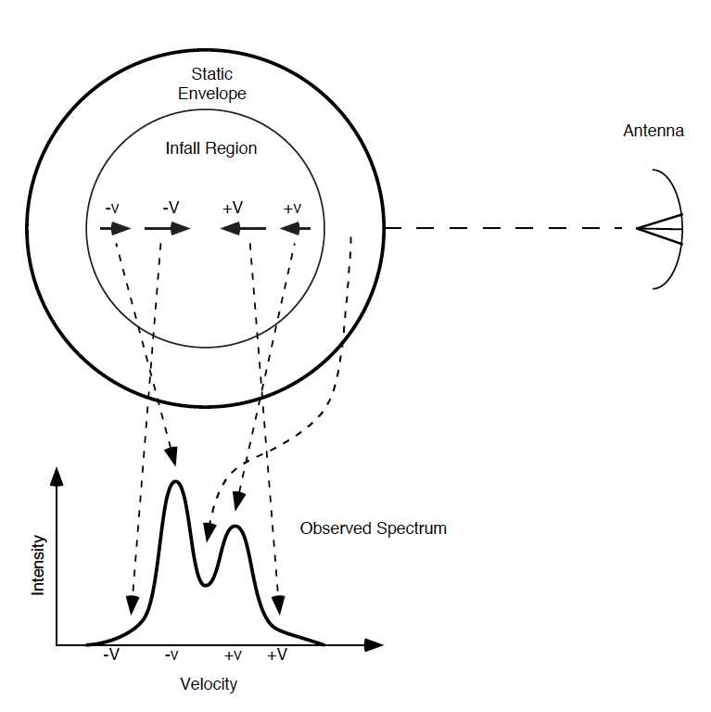
Infall in High-mass Star-forming Clumps
Infall Through The Evolution of High-mass Star-forming Clumps
Wyrowski et al. 2016, A&A, 585, A149
Instrument: GREAT
Previous observations of NH₃ J_{K} = 3₂₊ - 2₂₋ at 1.8 THz in three clumps were used to study infall. This study traced infall in a larger sample selected from an unbiased list of galactic plane targets covering a broad range of evolutionary stage and luminosity.
Background
The infall process is key to our understanding of the details of accretion in star formation. A critical tool needed to study infall is high resolution spectroscopy.
Optically thin emission probes the mean velocity through the whole envelope, whereas optically thick lines split into blue- and red-shifted lines (blue-skewed lines) and probe the structure of the envelope. We can observe both components by observing red-shifted absorption lines in front of bright continuum sources.
Physical structure of the clumps constrained by SED and 870 mm continuum emission T, n, R_{out} RATRAN modeling of HCO⁺ (red) with variable Abundance with & without (dotted) outflow components. APEX HCO⁺ (4-3) vs SOFIA NH₃ absorption.
Background Image Credit: ESO/APEX/ATLASGAL
consortium/NASA/GLIMPSE consortium/ESA/Planck

