Slide 1
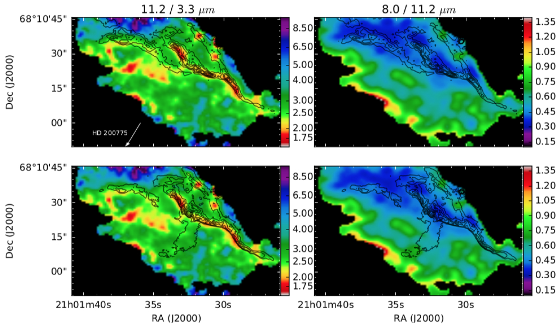
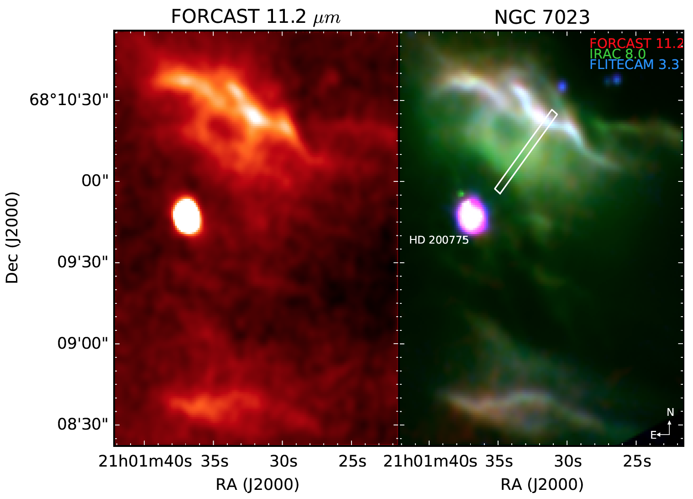
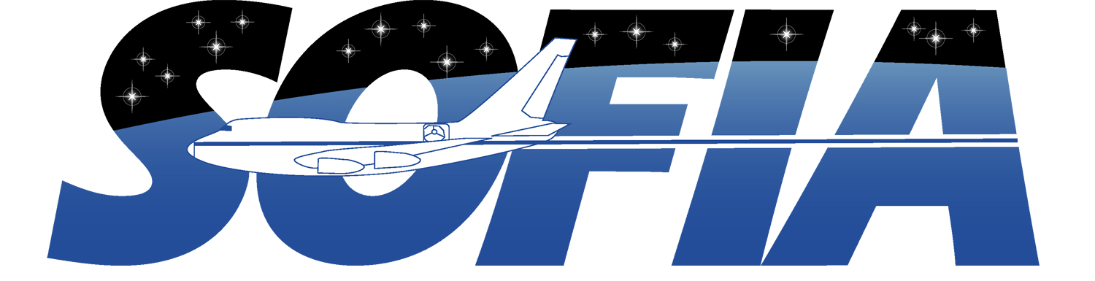
Mapping PAH Sizes in NGC 7023: Iris Nebula in Cepheus
Mapping PAH sizes in NGC 7023 with SOFIA
Croiset et al. 2016, A&A, 590, A26
Instruments: FORCAST at 11.2 µm & FLITECAM at 3.3 µm
Background
NGC 7023 exhibits strong emission from polycyclic aromatic hydrocarbon (PAH) molecules and is illuminated by the nearby triple binary star system HD 200775.
Emission features at 3.3, 6.2, 7.7, & 11.2 µm are typically attributed to IR fluorescence from UV-excited PAHs. Processing of PAHs by UV photons is shown by evolution of the PAH size distribution with changing physical conditions.
Above: Colors correspond to 11.2/3.3 µm ratio, a tracer of PAH size (left panels) and 8.0/11.2 µm ratio, a tracer of ionization fraction (right panels). Contours trace the H₂ emission (top panels) and extended red emission (bottom panels).
NW PDR is edge on with illumination from HD 200775 to the SE. The star has a cavity with a dense molecular cloud surrounding it. PAH emission extends along the PDR’s surface & coincides with the H₂ and ERE emission.
Background image credit: Tony Hallas

Slide 2
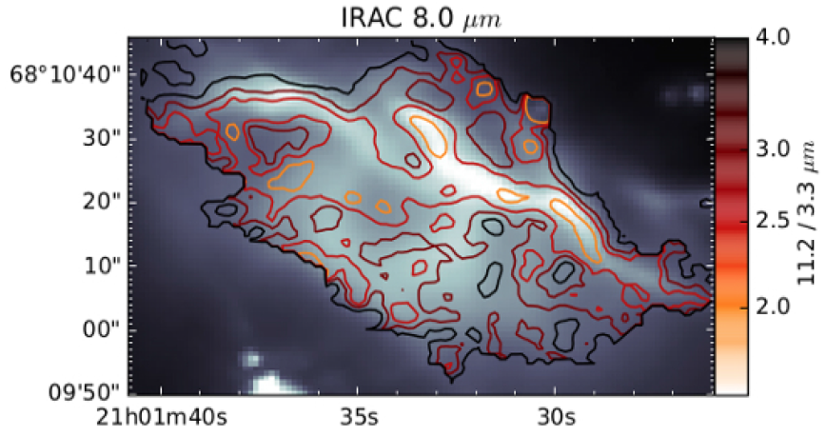
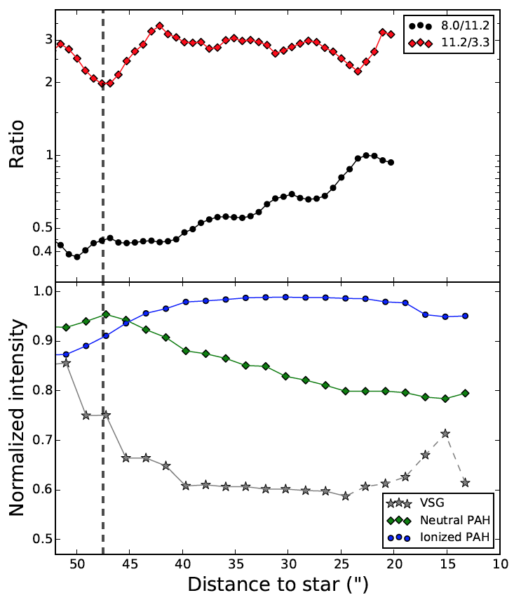
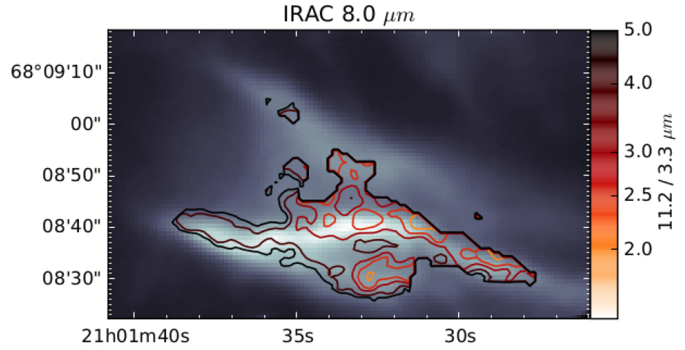
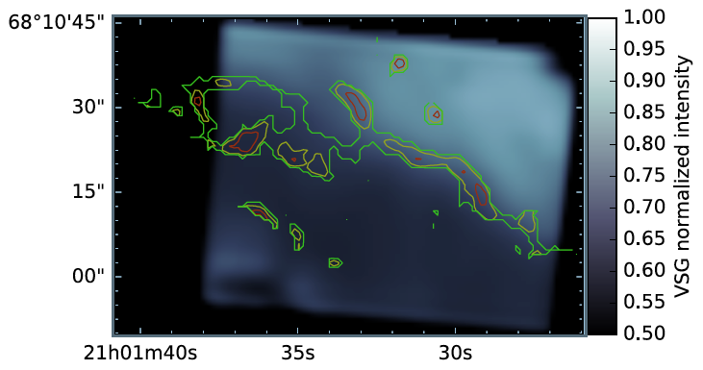
Mapping PAH Sizes in NGC 7023: Iris Nebula in Cepheus
The 11.2/3.3 µm reveals that the smaller PAH molecules (~50 molecules) are found preferentially near the PDR surfaces and that the typical size increases into the cavity.
This suggests that the smaller PAHs are destroyed as they become exposed. Likewise, the 8.0/11.2 µm ratio increases from the PDR into the cavity, indicating an increase in ionization.
These data support the model wherein the FUV flux evaporates PAH clusters into PAH constituents at the edge of the cloud. These free-floating PAHs, exposed to the UV field, are dissociated with only the larger, more stable molecules surviving.
VSG emission overlaid by 11.2/3.3 µm ratio contours
IRAC 8.0 µm images of the North (top) & South (bottom) PDR overlaid with 11.2/3.3 µm contours
Background image credit: Tony Hallas

