Slide 1
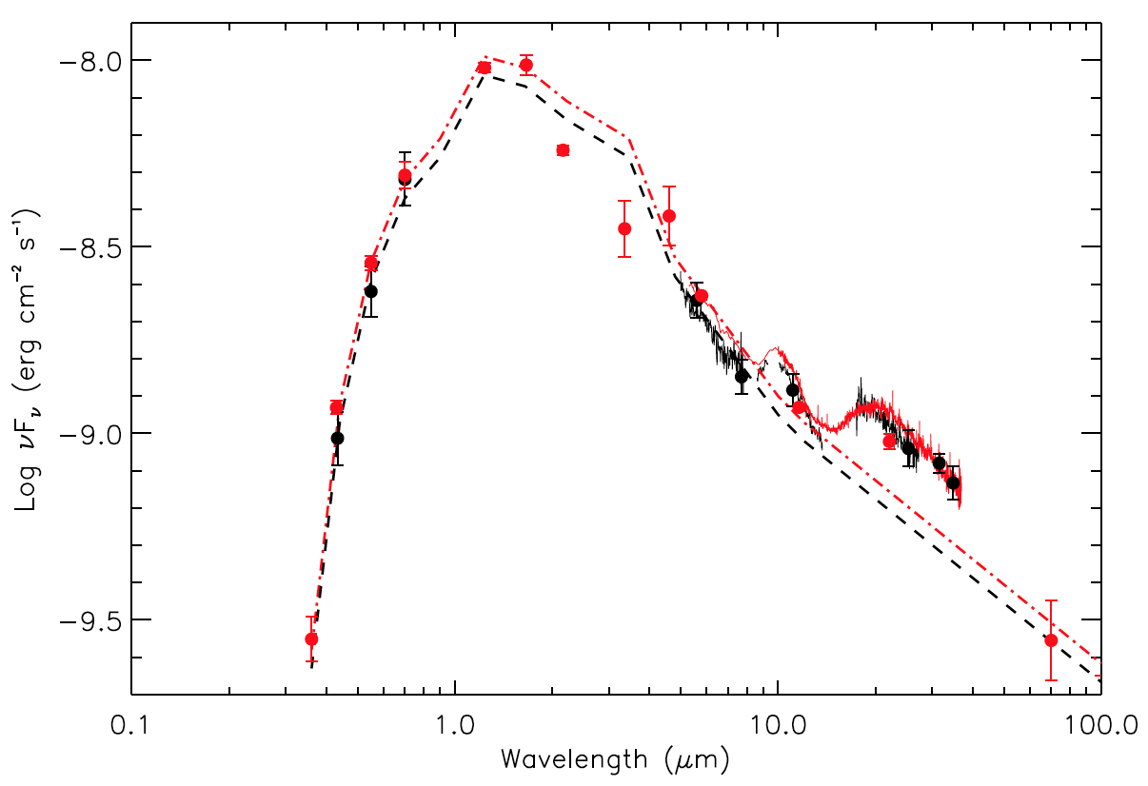
Changes in the YSO FU Ori Disk
The Mid-Infrared Evolution of the FU Orionis Disk
Green et al. 2016, ApJ, 832, 4
Instrument: FORCAST
Background
FU Ori is the canonical example of an FU Orionis object, a class of stars that undergo sudden brightening events followed by a gradual decline to quiescent magnitude. Brightening is thought to be due to cataclysmic accretion from the surrounding disk, which arises from disk instabilities. These processes are described by three competing models:
Inside-out: The instability arises at a few AU, where lower temperatures and ionization fraction disrupt the accretion
Outside-in: Gravitationally bound clumps of material migrate in from 10s of AU to accrete directly onto the star
An external perturber disrupts the accretion disk, forming a cascading flow
Spline fits to the Spitzer (red data, green fit) & FORCAST (black data, blue fit) data
— Spitzer/IRS spectra from 2004 + pre-2011 optical photometry
-•- 7200K modified blackbody
— FORCAST spectra from 2016 + AAVSO photometry
-•- 7200K modified blackbody; intensity reduced by 12%
Spline removed spectrum of the silicate features
Comparisons between 2004 Spitzer-IRS and 2016 SOFIA-FORCAST data revealed a 12% decrease in flux from 5-14 µm, only a <~7% change at longer wavelengths, and no change to overall SED shape, silicate features, or H₂O absorption profiles. This suggests that following the outburst the innermost, hottest regions of the disk have either been cooled or been depleted by accretion
Spline removed spectrum of the 10 µm silicate feature using identical spline anchor points
Background Image: FU Orionis
Credit: ESO

