Slide 1
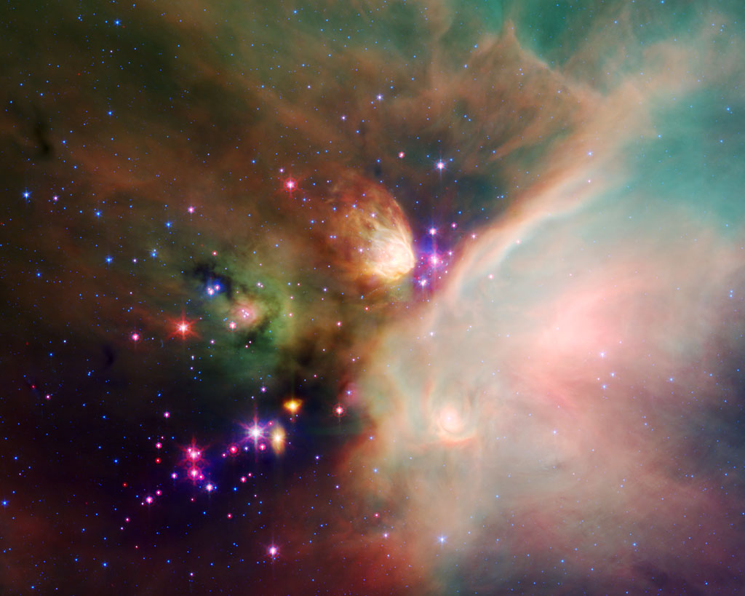
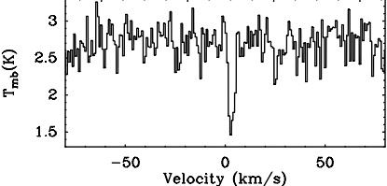
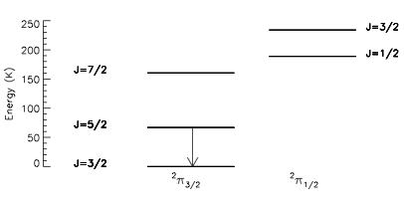
First Detection of OD outside the Solar System
Parise et al. 2012, A&A
Ground state transition:
Sensitive to cold gas
OD J=5/2->3/1 transition observed toward protostar IRAS16293, smoothed to 0.79 km/s
In cold and dense clouds, chemical reactions forming molecules with Hydrogen prefer the isotope Deuterium. This process, called fractionation, leads to relatively high abundances of deuterated molecules.
Fractionation is driven by the fact that the heavier molecule (OD) has a lower energy ground state than the lighter one (OH)
SOFIA/GREAT observations detected OD, the deuterated form of the hydroxyl radical, OH, which is important in the chemical pathway for forming water, in the protostar IRAS 16293-2422.

Slide 2
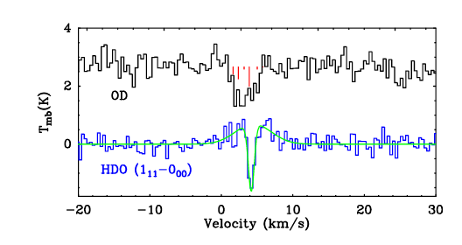
First Detection of OD outside the Solar System
SOFIA observations were made with the German Receiver at Terahertz frequencies (GREAT)
Herschel recently detected ND, the deuterated form of NH, and found a very high fractionation (Bacmann et al. 2010), but
Herschel could not observe OD because it was outside the frequency range of its HIFI spectrometer.
The SOFIA spectrum of OD shows a similar velocity profile to the Herschel spectrum of deuterated water, HDO, after taking into account the hyperfine structure of OD (red bars).
The inferred abundance of OD is 17-90 times more than HDO, higher than predicted by chemistry models
Interpretation would benefit from improved measurement of OD collision rates

