Slide 1
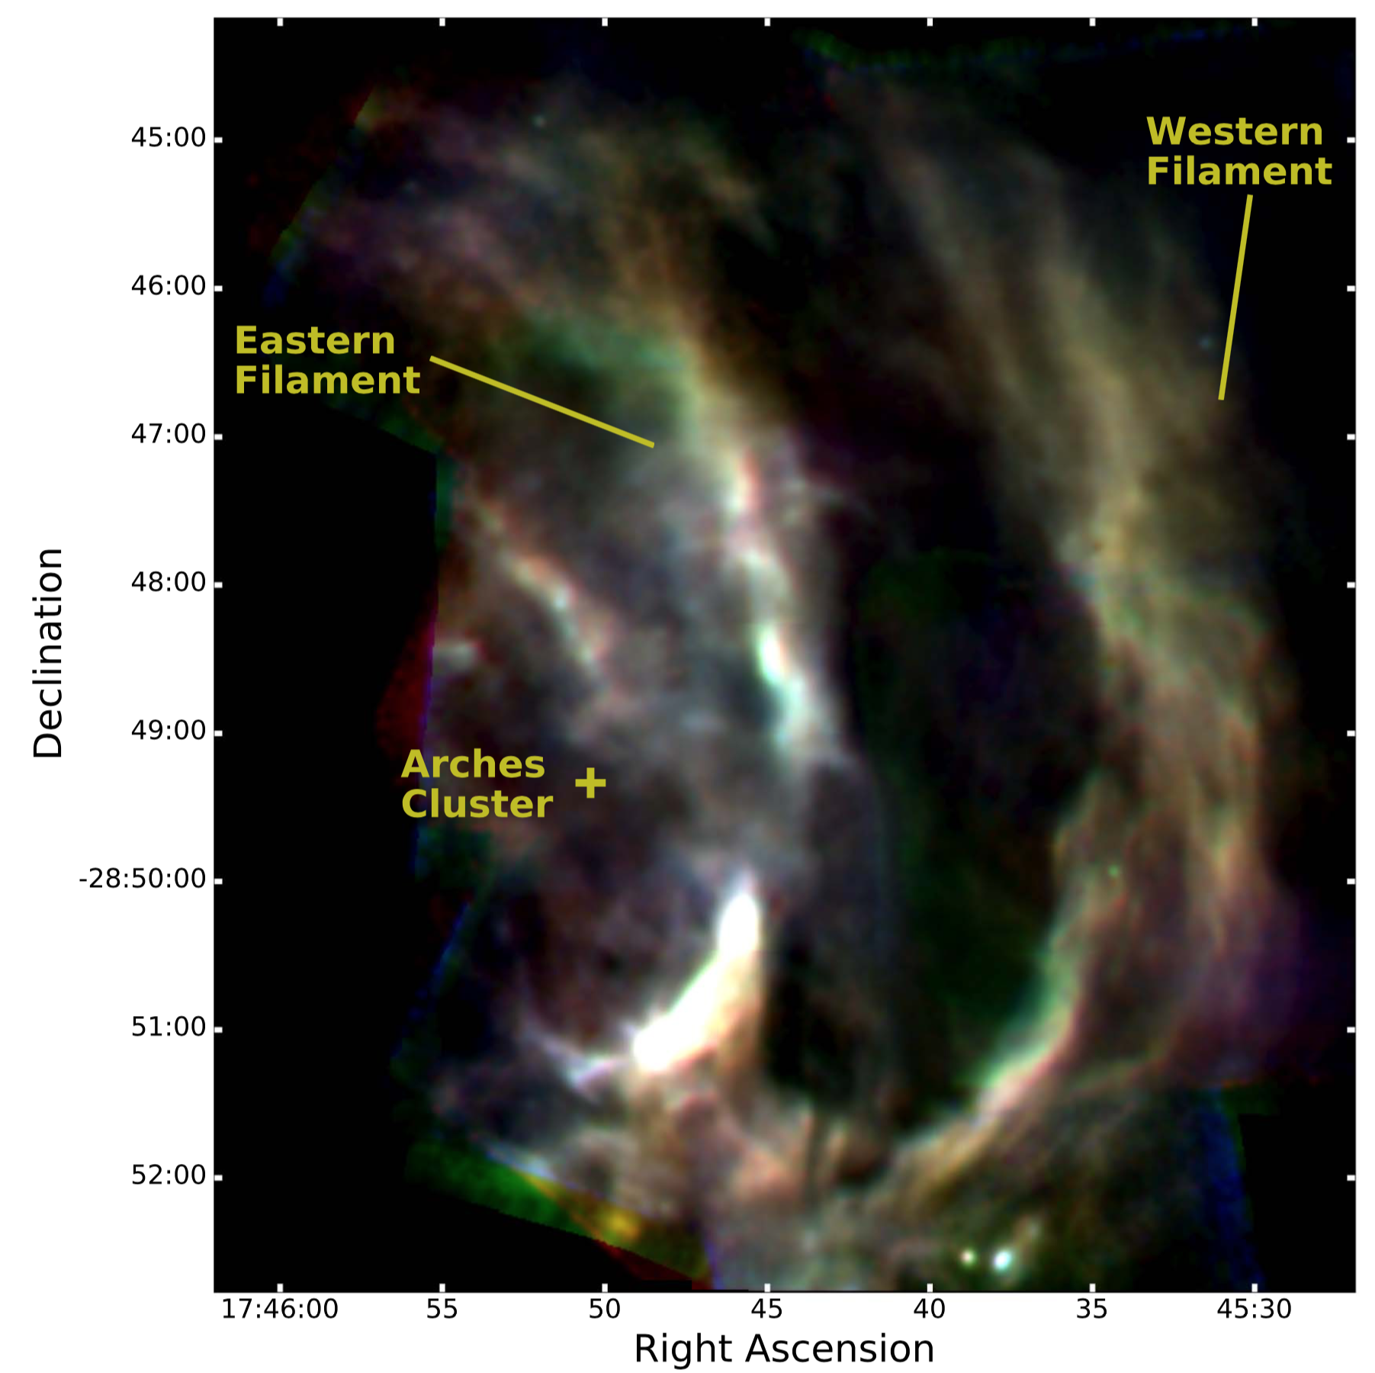
Arched Filaments Color-Temperature Map
An Infrared Study of the Dust Properties and Geometry of the Arched Filaments HII Region
Hankins, M.J., et al., 2017, ApJ, 852, 9.
Instrument: FORCAST, FWHM ~3.2-2.8 arcsec at 19.7, 25.2, 31.5, and 37.1 μm
25.2/37.1 μm Color-Temperature Map
Background
The Arched Filaments are heated, ionized edges of molecular clouds near the galactic center. The region exhibits an unusually uniform radiation field for its size (~25 pc), and the nearby Arches stellar cluster is a hypothesized source of heat and, through its winds, morphology effects on filament grains. Additionally, the galactic center’s warm, dense environment yields a habitat for efficient grain growth—providing the basis for an assumption of the filament grain size of 0.1 μm .
However, studying the relationship between the filaments and cluster is difficult due to the geometry of the filaments. The high spatial resolution capabilities of FORCAST have enabled an investigation of the heating source, morphology, and grain processing mechanism of the filaments through the production and analysis of color-temperature maps.
Analysis of the color-temperature map suggests the cluster is responsible for the uniform heating of the filaments, but the cluster wind momentum is not sufficient for morphology effects and is likely attributed to tidal shearing from the galactic center.
FORCAST False Color Image of Arched Filaments
Significantly, temperature uniformity results are only consistent if the silicate grain size is smaller than previously thought, (0.01 μm vs 0.1 μm). Possible reasons for this deviation include nonthermal sputtering from approaching cluster winds, shocks from nearby supernovae, and high-velocity grain collisions from turbulence in the galactic center shattering the otherwise expected larger grains.
25.2 μm (blue), 31.5 μm (green), and 37.1 μm (red)
Background Image: Stars at the Galactic Center
Image Credit: Susan Stolovy (SSC/Caltech) et al., JPL-Caltech, NASA

