Slide 1
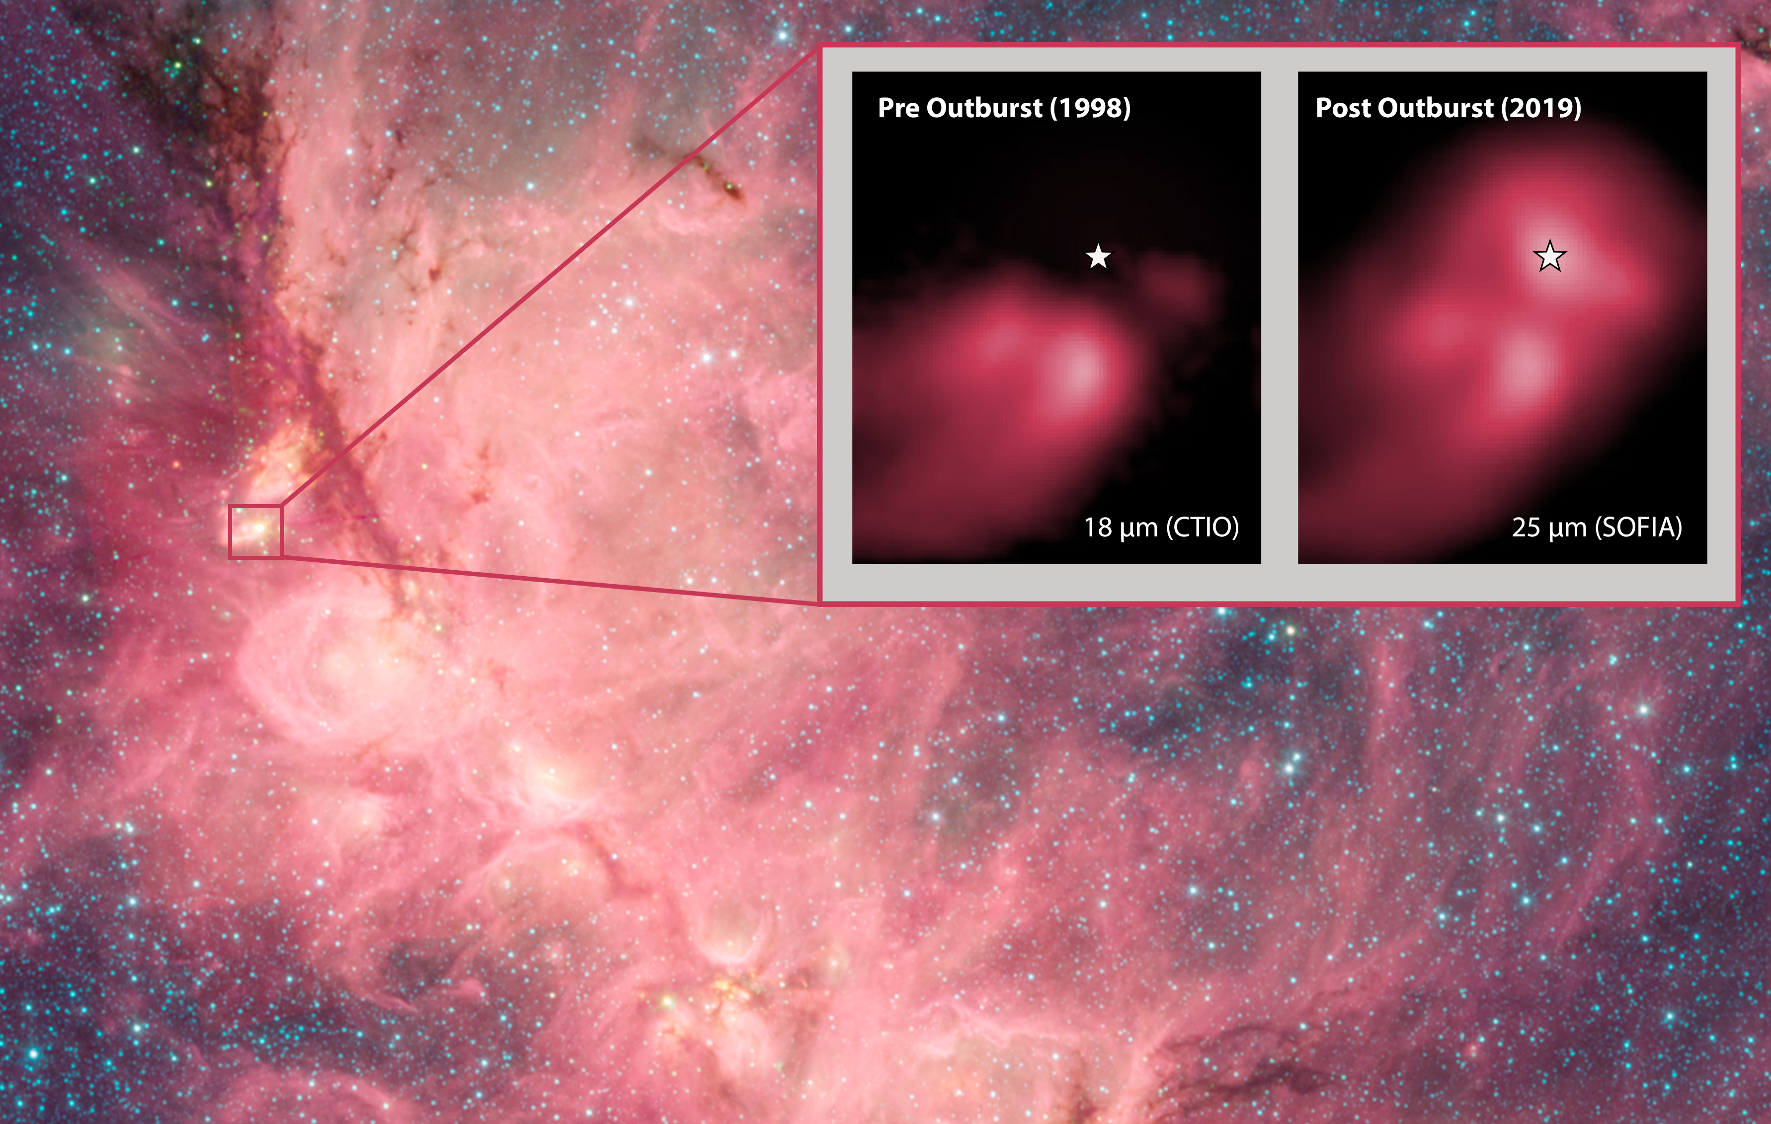


Episodic Accretion in High-Mass Protostars
ALMA researchers discovered a millimeter outburst from a massive protostar in NGC 6334 I, which was so deeply embedded that it was only observable prior to the outburst at millimeter-to-radio continuum wavelengths
SOFIA/FORCAST/HAWC+ observations revealed that infrared emission from the protostar had also increased considerably; the protostar could now be seen in the infrared and was also now the brightest infrared source in the entire proto-cluster
Results indicated that the protostar has an outburst luminosity of almost 50,000 L_sun, 16 times higher than the pre-outburst value. The SOFIA data were vital in determining an accurate measurement of this post-outburst luminosity.
Paper: “The Extraordinary Outburst in the Massive Protostellar System NGC 6334 I-MM1: Strong Increase in Mid-Infrared Continuum Emission”
Hunter, T. R., et al., 2021/05, ApJL, 912, L17.
Image credit: Cat’s Paw Nebula: NASA/JPL-Caltech; Left inset: De Buizer et al. 2000; Right inset: Hunter et al. 2021
Notes:
Paper DOI: http://doi.org/10.3847/2041-8213/abf6d9
High-res image link: https://www.sofia.usra.edu/sites/default/files/Public/SCI2021_013.png
Science Spotlight: https://www.sofia.usra.edu/multimedia/science-results-archive/episodic-accretion-high-mass-protostars

Slide 2
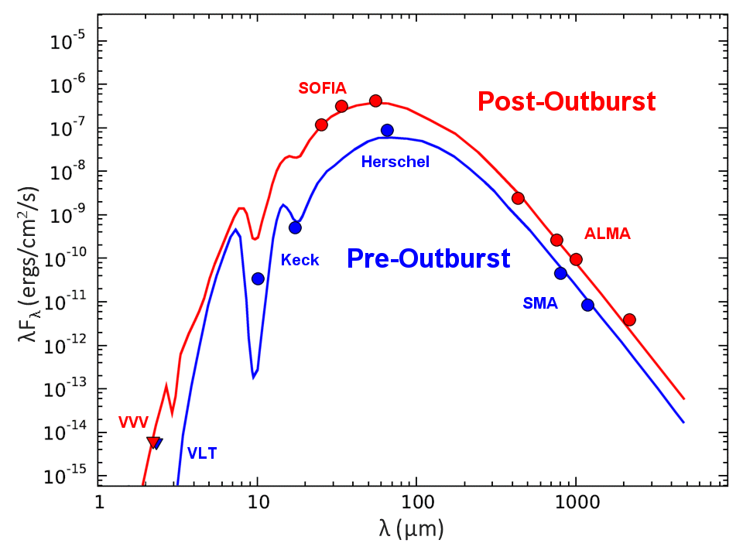
Episodic Accretion in High-Mass Protostars
Pre-outburst (blue) and post-outburst (red) spectral energy distributions from radiative transfer models for the episodic accretion event in NGC 6334 I. Blue data points are from the Very Large Telescope, Keck, Herschel, and the Sub-Milimeter Array. Red data points are from VISTA Variables in the Via Lactea (VVV) Survey, SOFIA, and ALMA.
Image credit: Hunter et al. 2021
Notes:
High-res image link: https://www.sofia.usra.edu/sites/default/files/Public/SCI2021_013.png

