Slide 1
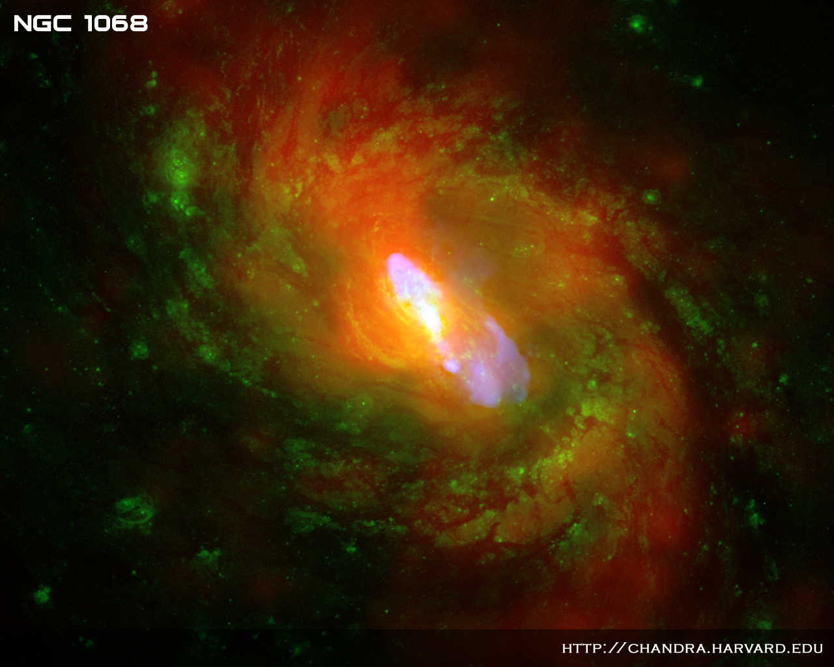
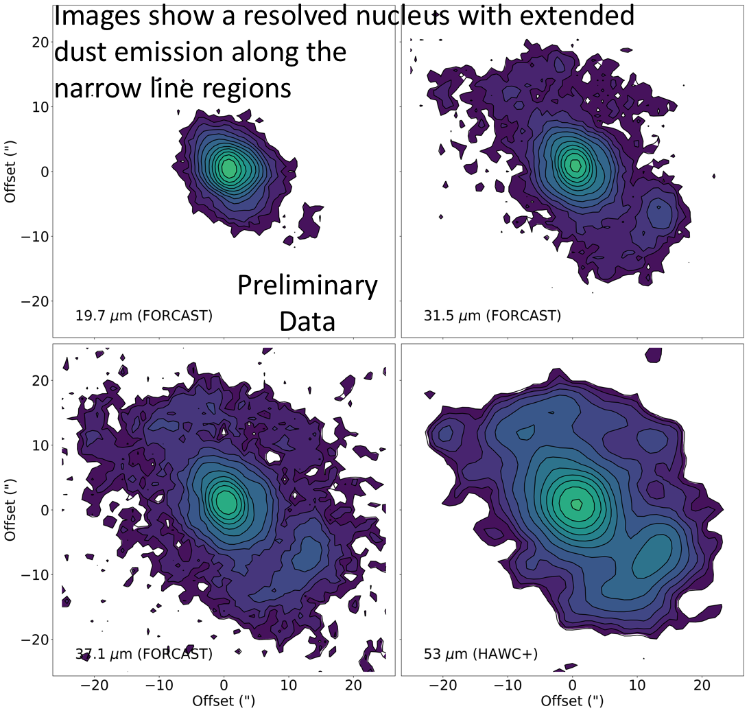
NGC 1068 Torus Emission Turn-over
Images show a resolved nucleus with extended
dust emission along the
narrow line regions
First Detection of the Turn-over of the Torus Emission in NGC 1068
Lopez-Rodriguez, E., et al., submitted to ApJ
Instruments: HAWC+ at 53 μm and FORCAST at 20–40 μm
Preliminary Data
Background
The cornerstone of the unified model of AGN is the torus: the surrounding dust obscuring the black hole and accretion disk in the center of active galaxies. Obtaining physical information about the torus necessitates spectral energy distribution modeling using high angular resolution to isolate the torus emission from extended diffuse dust emission, star formation regions, and/or host galaxy.
The silicate feature at 10 μm and 18 μm, the NIR emission, and the luminosity of the torus at 10 μm show that the torus is formed by a clumpy distribution of optically thick dust surrounding the central engine. Moreover, clumpy torus models and observations of the turn-over of the torus emission suggest that the 10–200 μm region best constrains the torus radius along with the number and radial distribution of clouds.
Preliminary Data
Preliminary Data
Once the torus emission was isolated, it was fit using the CLUMPY torus model to obtain physical properties about the torus.
The turn-over of the torus emission occurs at 30-40 μm.
Background image: Composite of NGC 1086
Image Credit: X-ray (NASA/CXC/MIT/C.Canizares, D.Evans et al), Optical (NASA/STScI), Radio (NSF/NRAO/VLA)

