Slide 1
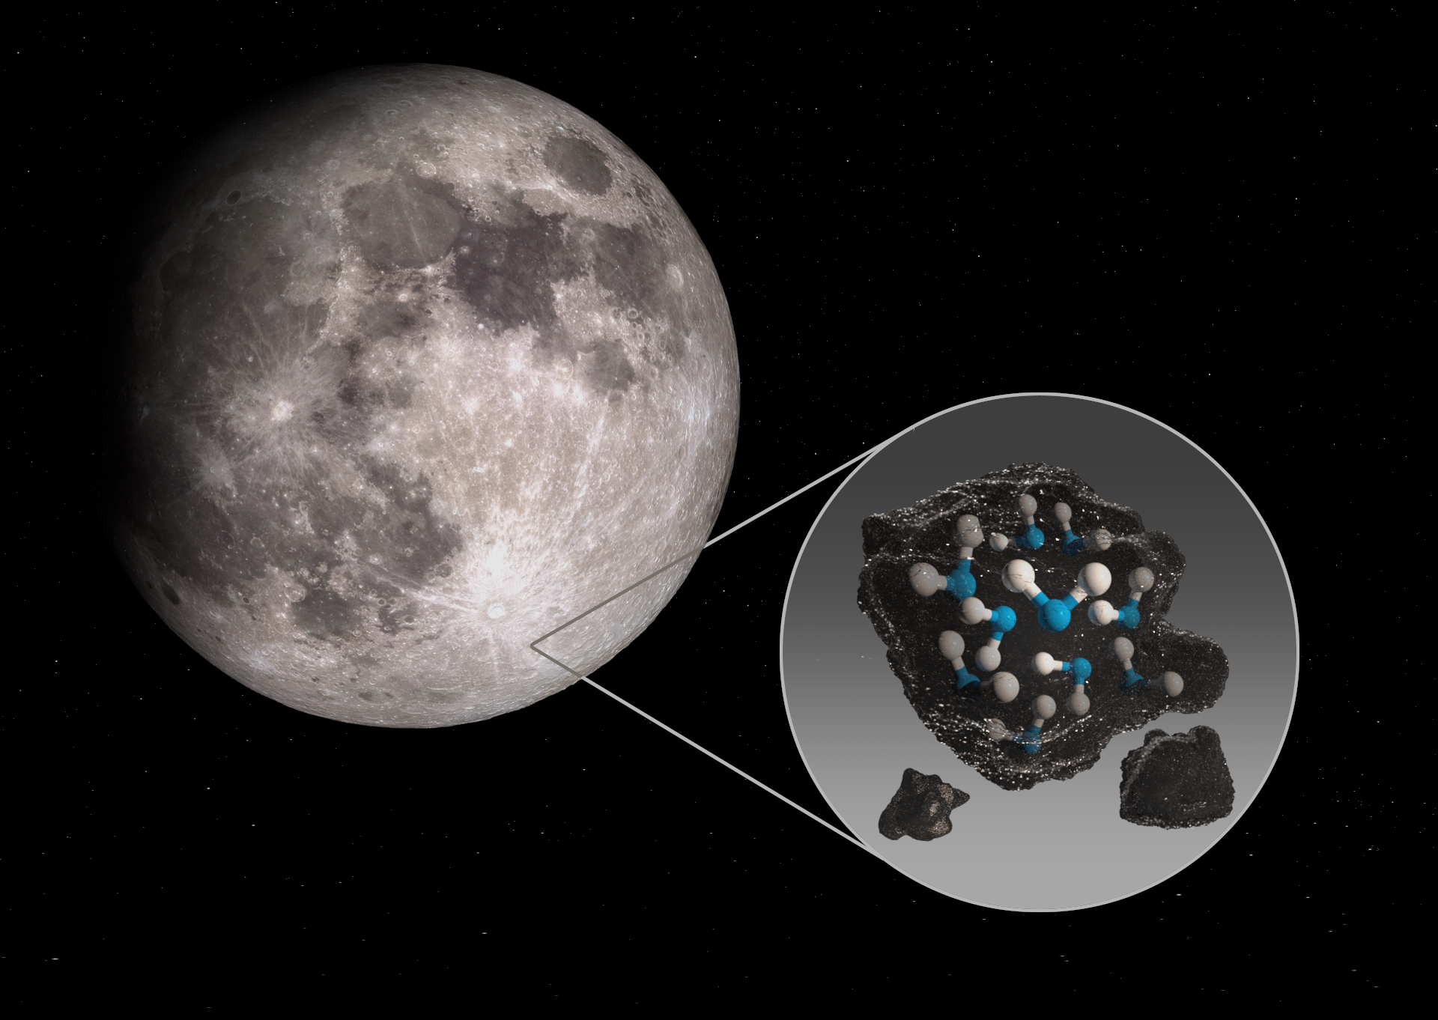


SOFIA Detects Water on the Moon
Researchers using SOFIA/FORCAST have made the ﬁrst-ever detection of the water molecule (H₂O) on the sunlit surface of the Moon. This discovery reﬁnes our understanding of the behavior of water and how volatile elements and compounds interact with airless bodies throughout the Solar System and beyond.
The fundamental bending vibration of the H-O-H molecular bond occurs at 6.1 µm in the infrared. This region of the spectrum is completely obscured from the ground by water in the Earth's atmosphere but is highly transparent from SOFIA's operational altitude. In addition, the spectral feature at 6.1 µm is unique to H₂O and does not suffer from blending from other OH-related compounds.
The team found water abundances of a few hundred parts per million, which is high by lunar standards. The results indicate that the water has a meteoritic origin or is produced on the lunar surface itself from pre-existing hydroxyl. The team also found that the abundance of water varies with latitude, suggesting that meteorites may not be the only source of water.
Image credit: NASA/Ames Research Center/Daniel Rutter
Paper: “Molecular water detected on the sunlit Moon by SOFIA”
C.I. Honniball, et al., Nature Astronomy 2020.Pabst, C. H. M., et al., 2020/07, A&A, 639A, A2.
Notes:
Paper DOI: https://doi.org/10.1038/s41550-020-01222-x
High-res image link: https://www.sofia.usra.edu/sites/default/files/Public/SCI2020_0012.jpg
Science Spotlight: https://www.sofia.usra.edu/multimedia/science-results-archive/sofia-detects-water-moon

Slide 2
SOFIA Detects Water on the Moon
SOFIA spectrum from the lunar Clavius Crater showing the first detection of the water emission bands at 6 µm
Image credit: Honniball et al., 2020.)

