Slide 1
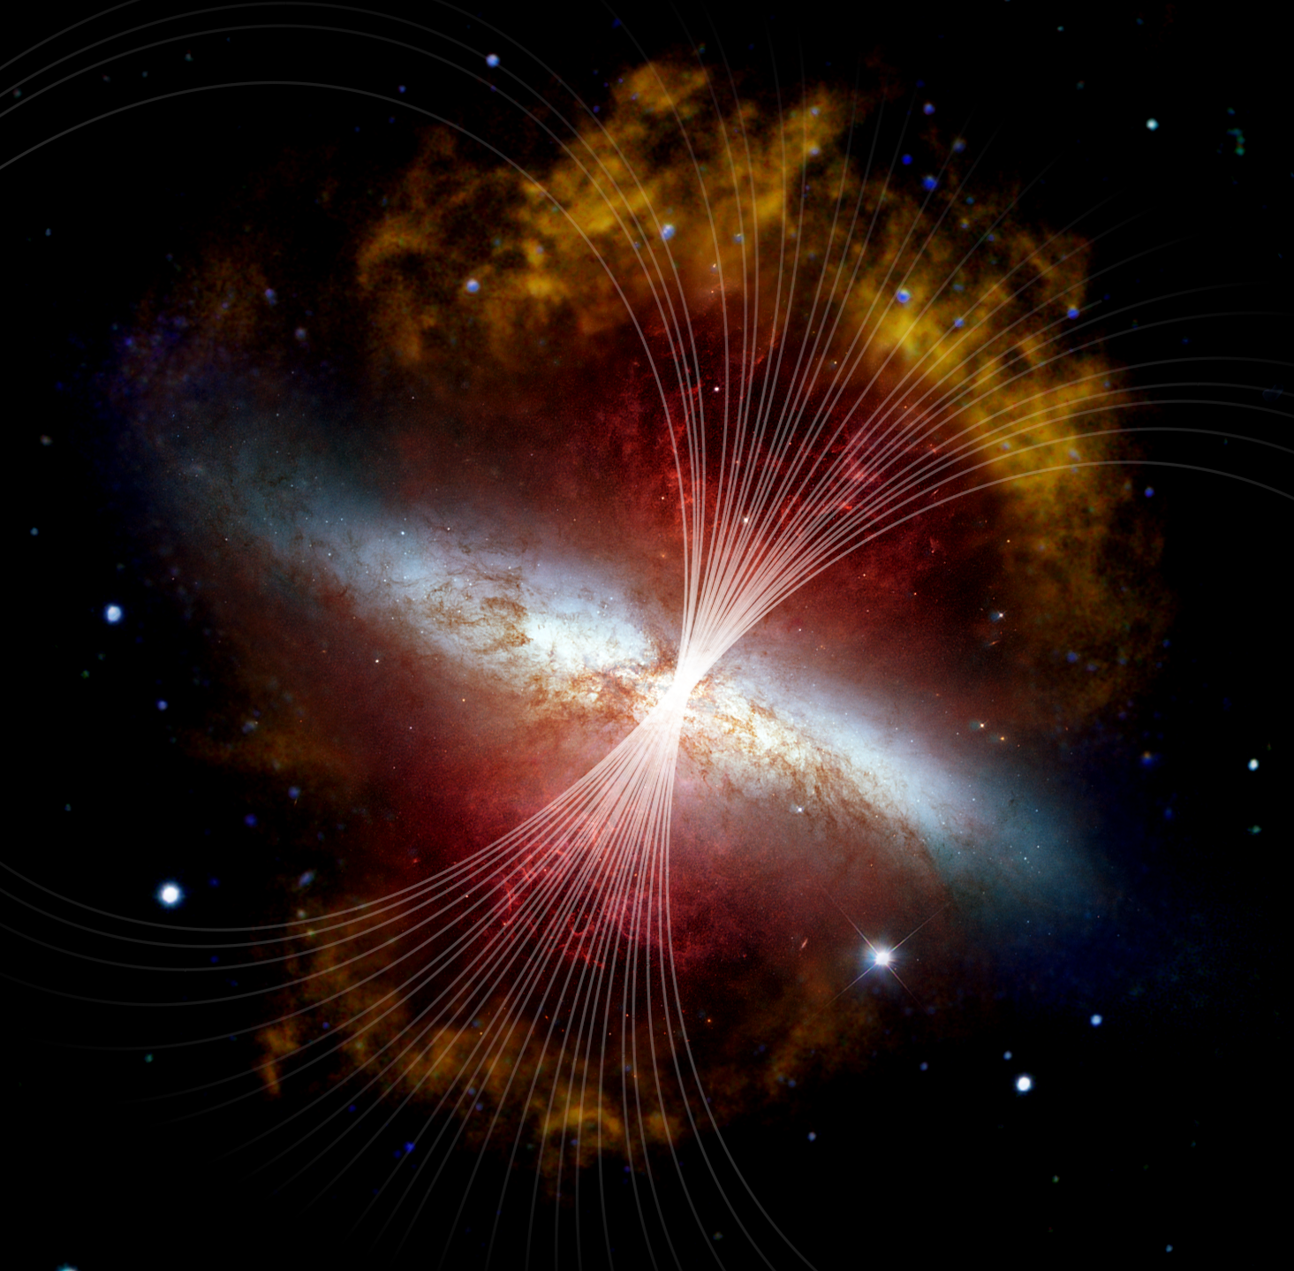
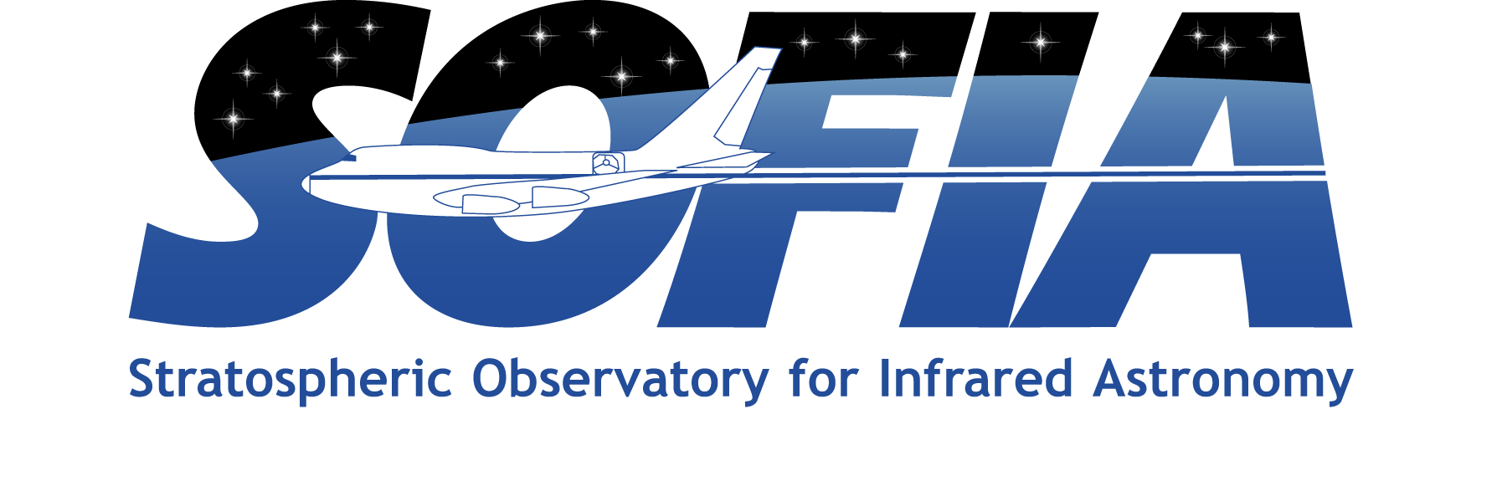

Magnetic Highway: Channeling the M82 Superwind
Observations of M82 reveal a bipolar superwind that originates in the core and extends out into the halo and beyond. Early observations from SOFIA/HAWC+ show that the geometry of the field at the base of the superwind is perpendicular to the plane of the galaxy, consistent with a scenario where the outflow is dragging the field along with it.
Do these magnetic field lines extend forever, channeling matter into intergalactic space, or do they turn over, directing material back to the galaxy in a giant feedback loop? Researchers used IR polarization data from SOFIA/HAWC+ and tools that have been utilized to study the physics around the Sun to extrapolate the potential magnetic field strength and structure up to 10 kpc around the galaxy.
The field lines appear to extend indefinitely into intergalactic space, like the Sun’s solar wind, creating magnetic highways that channel star-processed matter beyond the starburst core.
Paper: “The Strength and Structure of the Magnetic Field in the Galactic Outflow of Messier 82”
Lopez-Rodriguez, E., et al., 2021 ApJ 914 24
Image credit: NASA, SOFIA, L. Proudfit; NASA, ESA, Hubble Heritage Team; NASA, JPL-Caltech, C. Engelbracht
Notes:
Paper DOI: https://doi.org/10.3847/1538-4357/abf934
High-res image link: https://www.sofia.usra.edu/sites/default/files/Public/SCI2021_011.png
Science Spotlight: https://www.sofia.usra.edu/multimedia/science-results-archive/magnetic-highway-channeling-m82-superwind

