Slide 1
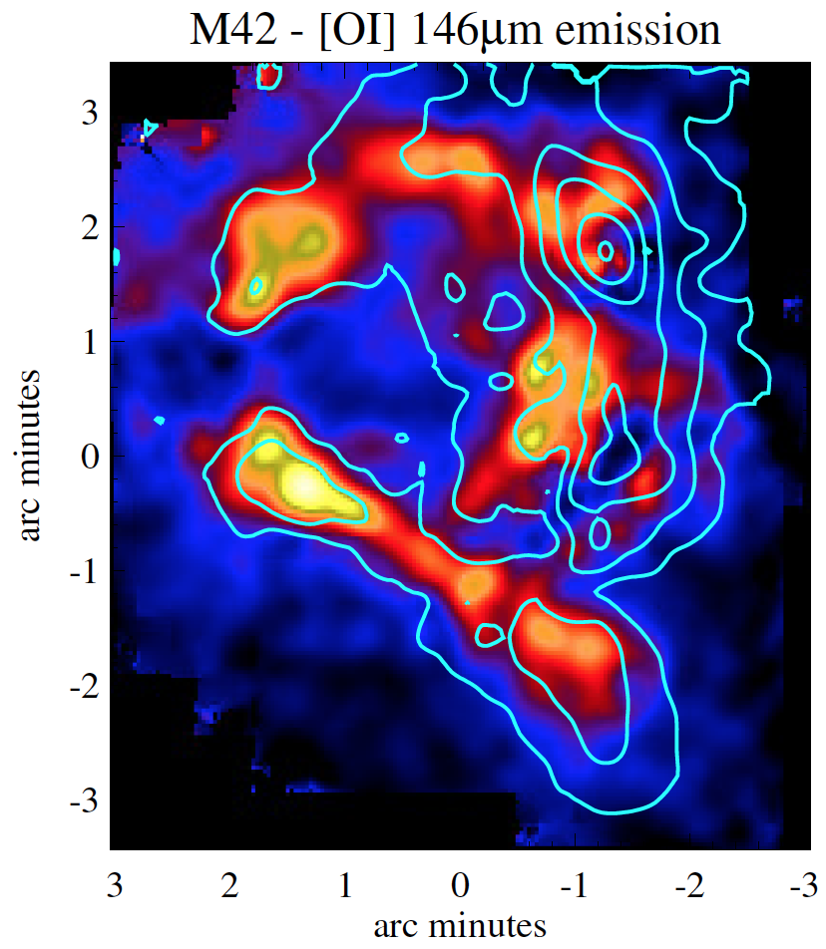
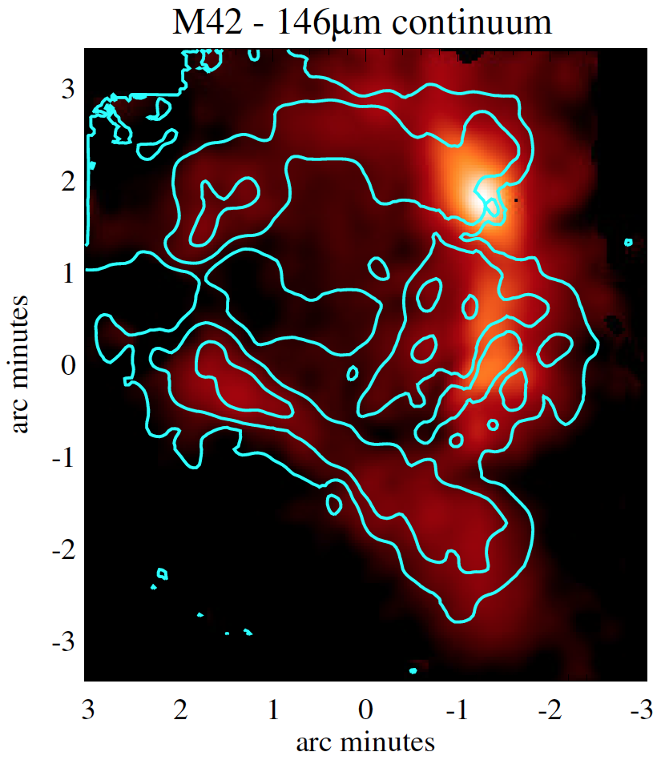
Orion Nebula
Instruments: 89 μm HAWC+ and 146 µm FIFI-LS
Background
HAWC+ polarization measurements at 89 μm capture the structure of the magnetic field in the Orion star forming region. Each line segment represents the orientation of the magnetic field at that location, overlaid on an image of the total intensity at the same wavelength. The total intensity image has a pixel scale of 1.5 arcsec per pixel and the polarization results were smoothed to a scale of 8 arcsec per pixel to produce statistically independent vectors in this HAWC+ observing band. For clarity, the line segments are set to a fixed length.
The Orion Nebula was mapped by FIFI-LS at 146 µm to study the physical conditions of its atomic and molecular gas. Left: The far infrared continuum is shown. The emission peaks at the Becklin-Neugebauer object but also clearly shows the Orion Bar and a similar structure to the north-east. Right: Additionally, the [OI] line emission traces the photon-dominated regions around the Trapezium stars where the star’s UV radiation irradiates the surrounding molecular cloud.
Background Image Credit: NASA, ESA, Hubble, HLA

