Slide 1
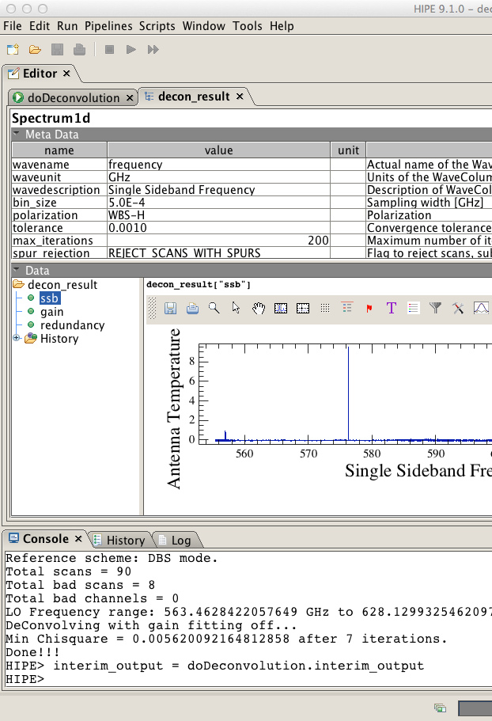
Sideband Deconvolution

Slide 2
Outline
What is sideband deconvolution and why it is necessary for HIFI data?
General description of the algorithm
Implementation within HIPE
Workflow for spectral scans
Notes:
Emphasis the why and the how.

Slide 3
Heterodyne observations
Detectors are not able to directly measure flux at the frequencies of interest. But by mixing the signal from the sky with a local oscillator, we `downconvert’ the frequency.
cos(ω)cos(ν_{LO})=0.5[ cos(ω-ν_{LO}) + cos(ω+ν_{LO}) ]
When ω is the entire, unfiltered sky frequency, you end up being sensitive to TWO bandpasses. (cos(ν) = cos(-ν))

Slide 4
Heterodyne observations
LSB
ν_{LO}
USB
What is being measured ->
Sky frequency
How it looks when collected->
IF

Slide 5
Heterodyne observations
LSB
ν_{LO}
USB
What is being measured ->
Sky frequency
How it looks when collected->
IF

Slide 6
Heterodyne observations
LSB
ν_{LO}
USB
What is being measured ->
Sky frequency
How it looks when collected->
IF

Slide 7
Heterodyne observations
LSB
ν_{LO}
USB
What is being measured ->
Sky frequency
How it looks when collected->
IF

Slide 8
Heterodyne observations
LSB
ν_{LO}
USB
What is being measured ->
Sky frequency
How it looks when collected->
IF

Slide 9
Heterodyne observations
LSB
ν_{LO}
USB
What is being measured ->
Sky frequency
How it looks when collected->
IF

Slide 10
Heterodyne observations
LSB
ν_{LO}
USB
What is being measured ->
Sky frequency
How it looks when collected->
IF

Slide 11
Heterodyne observations
LSB
ν_{LO}
USB
What is being measured ->
Sky frequency
How it looks when collected->
IF

Slide 12
Heterodyne observations
LSB
ν_{LO}
USB
What is being measured ->
Sky frequency
How it looks when collected->
IF

Slide 13
Heterodyne observations
LSB
ν_{LO}
USB
What is being measured ->
Sky frequency
How it looks when collected->
IF

Slide 14
Heterodyne observations
LSB
ν_{LO}
USB
What is being measured ->
Sky frequency
How it looks when collected->
IF

Slide 15
Heterodyne observations
LSB
ν_{LO}
USB
What is being measured ->
Sky frequency
How it looks when collected->
IF

Slide 16
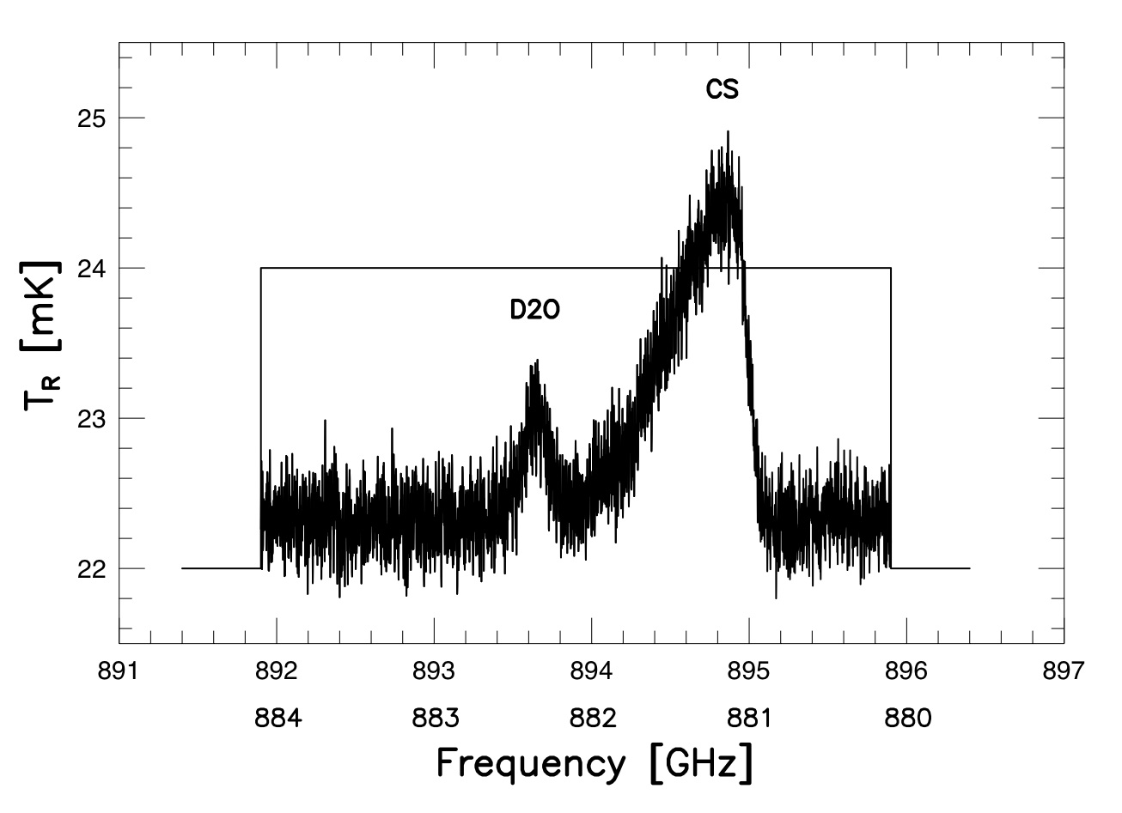
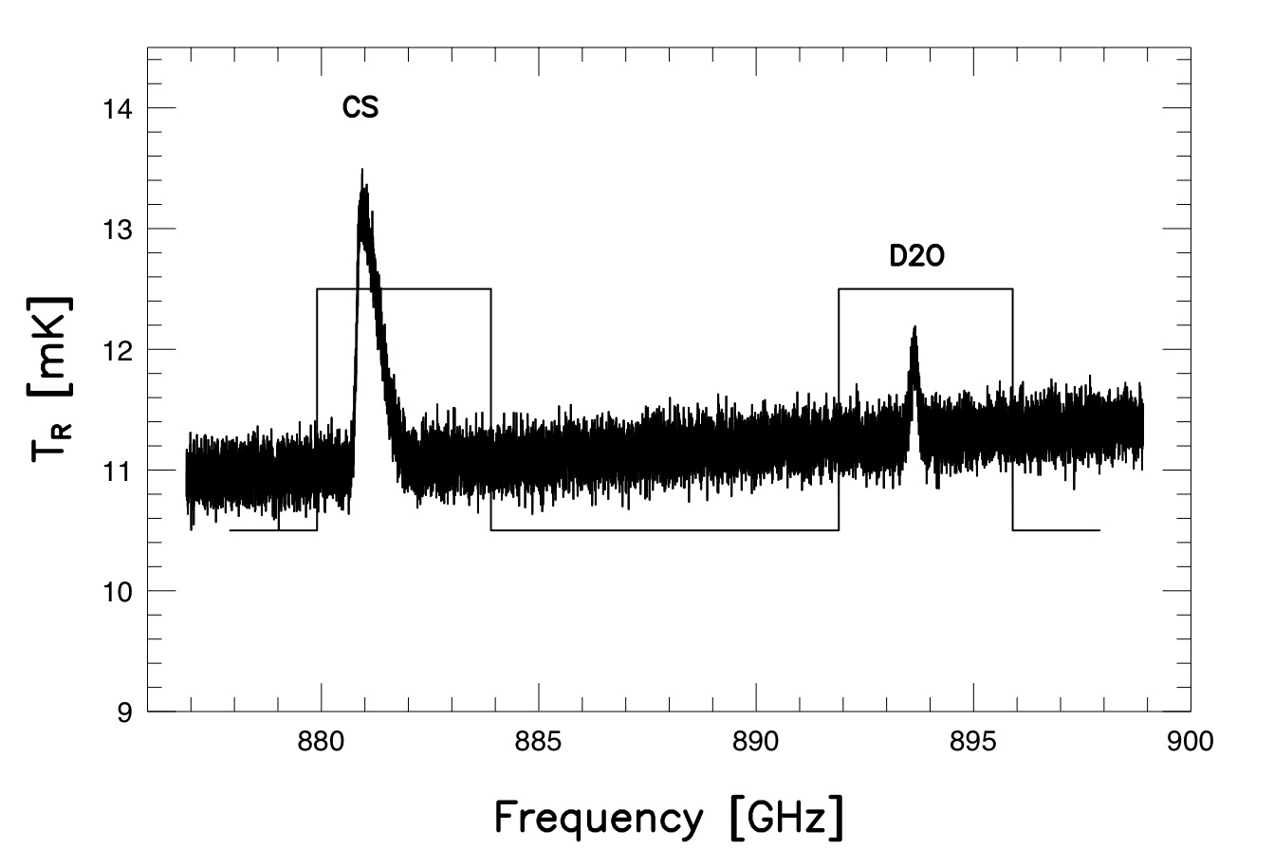
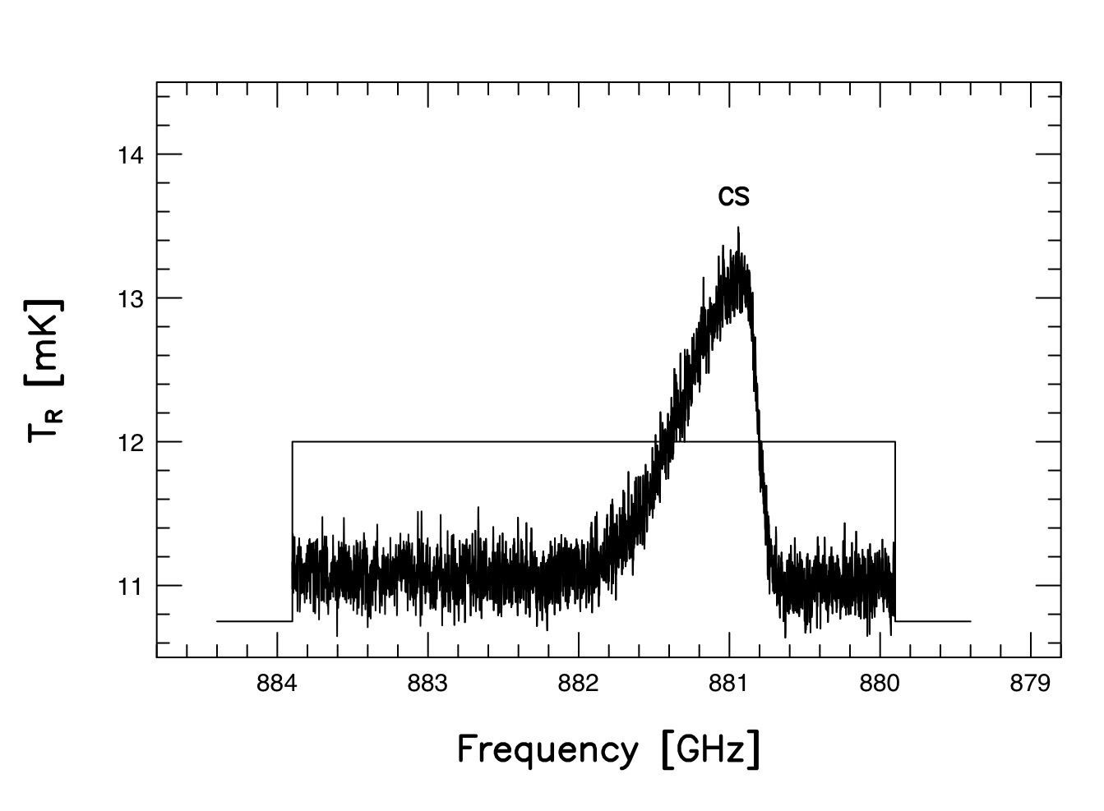
Heterodyne observations
LSB + USB = DSB
LO
Lower sideband spectrum is reversed and added
Two frequency scales result in the DSB result
The lines may blend but they can be recovered (deconvolved)
The continuum levels add (double) in the DSB
The continuum slope is flattened but may be recovered (deconvolved)
The noise adds in quadrature , increasing as sqrt(2)

Slide 17
Sideband Deconvolution
The problem is the following: Given a collection of double sideband data taken over several LO tunings, how do we recover the original ‘sky’ spectrum?
Comito & Schilke (2002) provide an algorithm which has been successfully employed with ground based heterodynes.
Has been implemented in CLASS + X-CLASS (Fortran based) but was converted to JAVA for use within HIPE. Upgrades to the algorithm have been almost exclusively within HIPE.
Notes:
Emphasis the why and the how.

Slide 18
Deconvolution Algorithm
Start with a guess of the answer – a model with no assumptions for the SSB spectrum – flat
"Observe it" – using knowledge of the instrument
compare the observations of the model with the real observations
compute a chi square and a delta (differential) chi-square
each model "spectral channel" was in part responsible for some of the chi square change
follow the slope of the chi square downward (it's partial derivitive w.r.t. the channel flux (and optionally the sideband gain)
new downward steps always move at right angles to previous ones in the Conjugate Gradient Method
Stop, when solution converges asymptotically, as defined by the "tolerance"
It’s iterative
Notes:
Emphasis the why and the how.

Slide 19
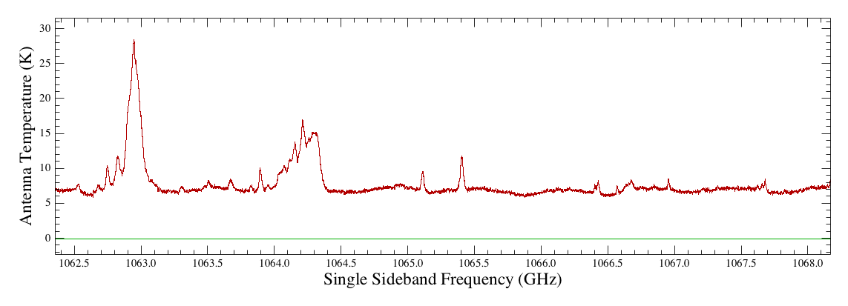
Example: Iteration 0
Notes:
Emphasis the why and the how.

Slide 20
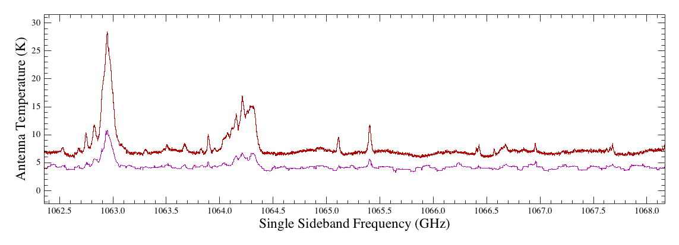
Example: Iteration 1
Notes:
Emphasis the why and the how.

Slide 21
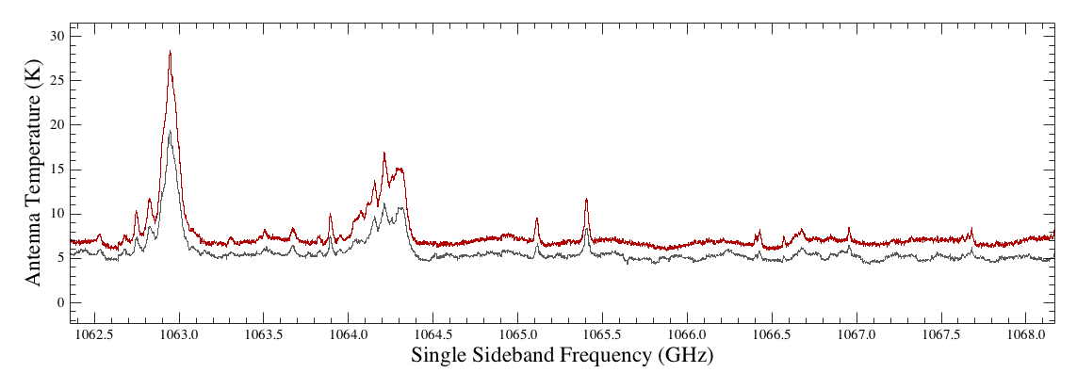
Example: Iteration 2
Notes:
Emphasis the why and the how.

Slide 22
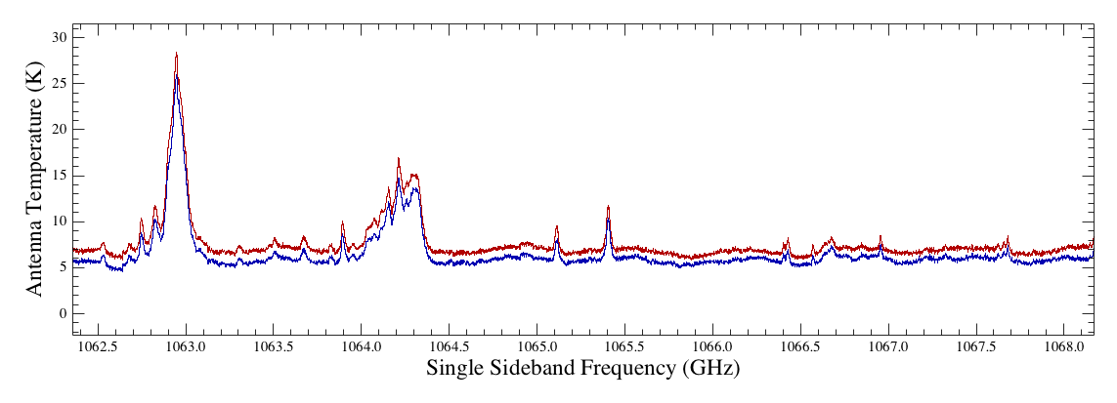
Example: Iteration 3
Notes:
Emphasis the why and the how.

Slide 23
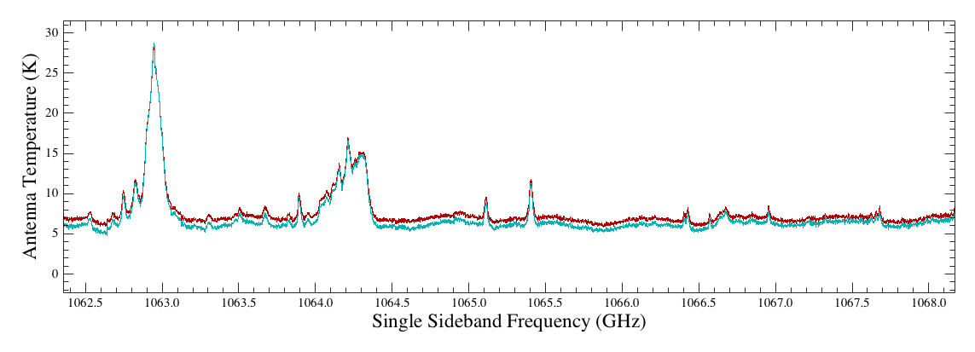
Example: Iteration 4
Notes:
Emphasis the why and the how.

Slide 24
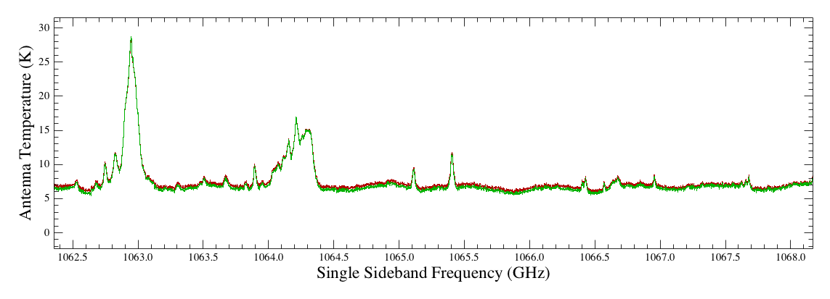
Example: Iteration 5
Notes:
Emphasis the why and the how.

Slide 25
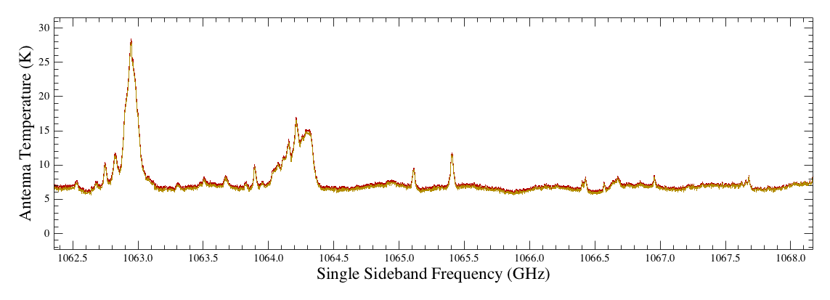
Example: Iteration 6
Notes:
Emphasis the why and the how.

Slide 26
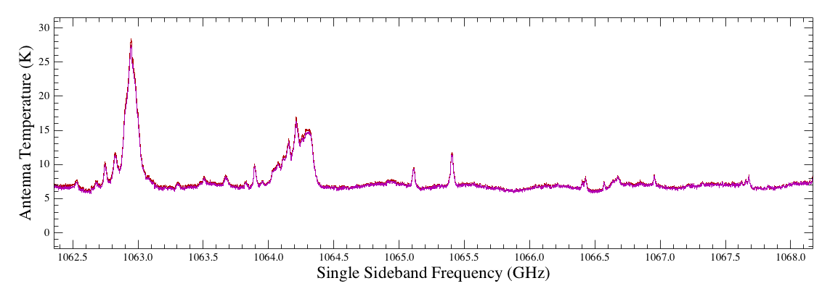
Example: Iteration 7
Notes:
Emphasis the why and the how.

Slide 27
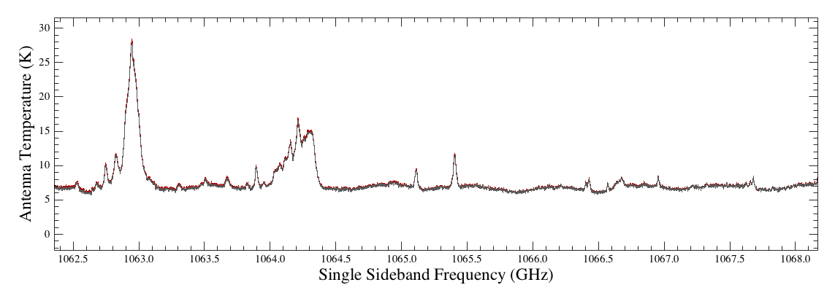
Example: Iteration 8
Notes:
Emphasis the why and the how.

Slide 28
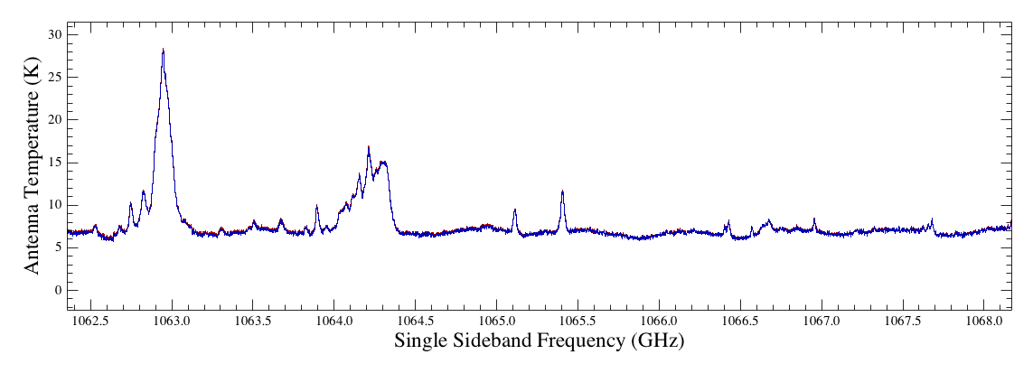
Example: Iteration 9
Notes:
Emphasis the why and the how.

Slide 29
doDeconvolution caveats
Iteration requires that the data make sense.
Sufficient redundancy (~100% of the time)
No spurs
Compatible baselines
No (or well behaved) standing waves
Most work is done before deconvolution
Notes:
Emphasis the why and the how.

Slide 30
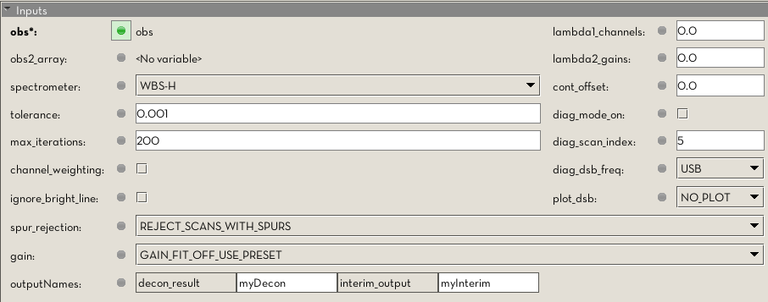
Decon GUI
Some features not recommended at all (may be deprecated in a later release)
Some features not used very often

Slide 31
Demos
Basic deconvolution
How unflagged spurs affect decon output
Carefully flagging bad data improves result
The diagnostic mode (advanced)
Ghosts and ‘Bright Lines’

