Slide 1
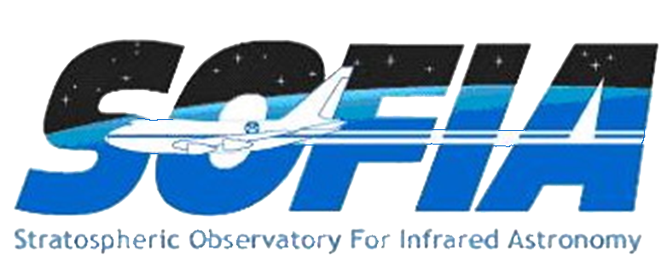
Introduction to SOFIA and
Airborne Infrared Astronomy
Erick Young
SOFIA Science Center

Slide 2
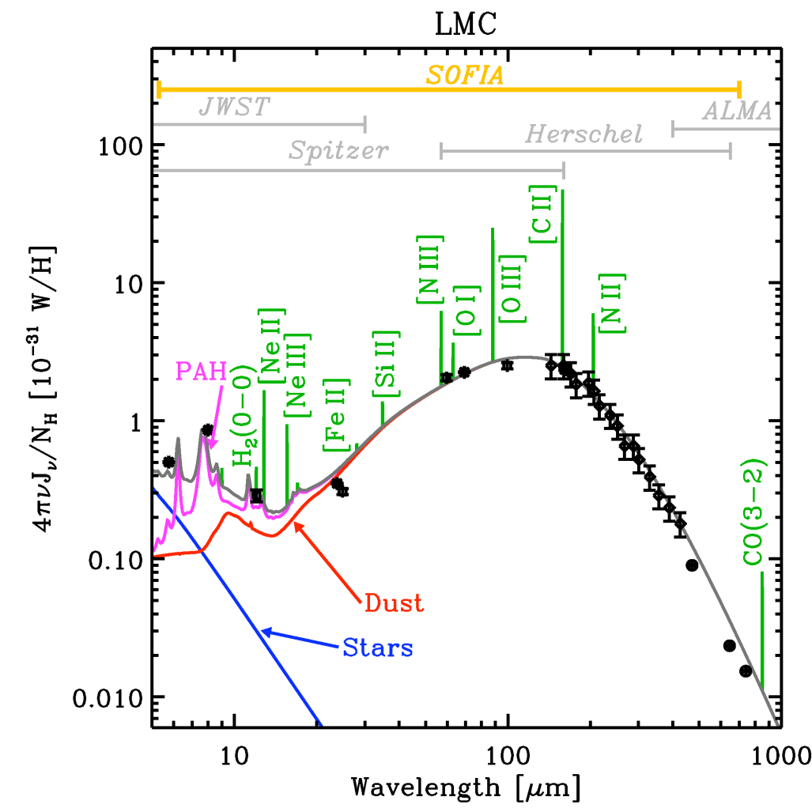
Importance of Far IR / Sub-mm
Most of the energy of star formation regions, external galaxies, and cooler objects in the universe is in the far-IR and Sub-mm
The most important emission lines responsible for the energy balance of the Interstellar Medium are in the far-infrared
The spectral energy distribution of the entire LMC, based on data from Spitzer, IRAS and FIRAS (Bernard et al. 2008). SEDS are fitted with the dusty PDR model of Galliano et al. (2008).
Figure courtesy of Galliano.

Slide 3
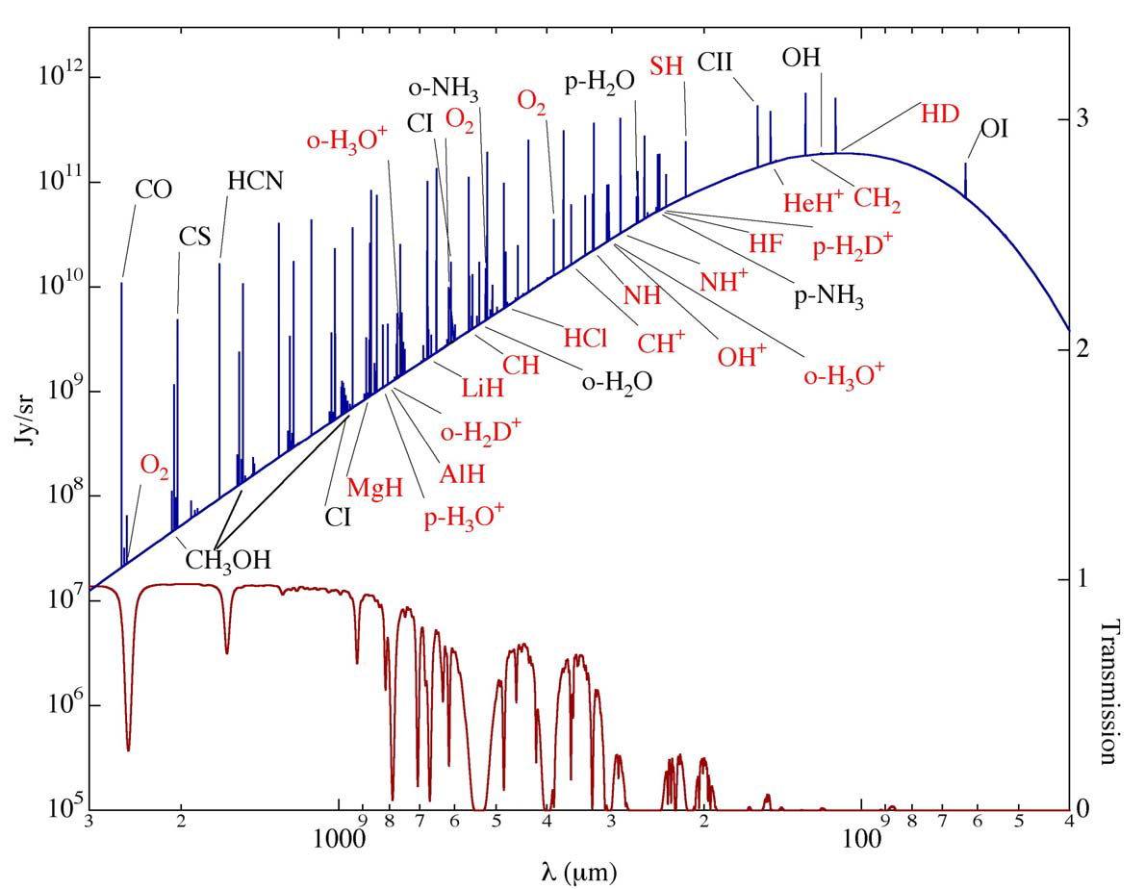
Importance of Far IR / Sub-mm -2
Most of the key atomic and molecular tracers of the interstellar medium are in the Far Infrared and Sub-mm
Molecular Cloud Spectrum
Ted Bergin, 2008

Slide 4
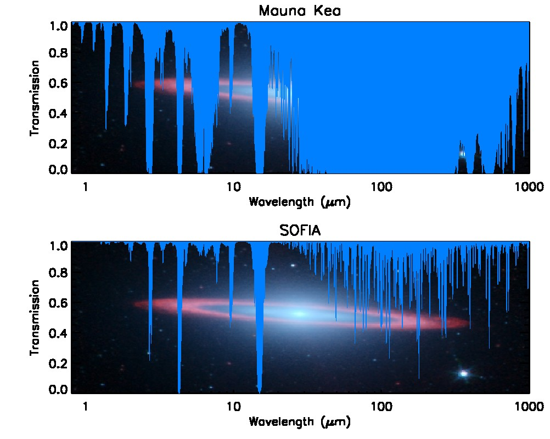
Motivation for SOFIA
The infrared is a key part of the spectrum for studying young stars, galaxies, planets, and the interstellar medium.
The Earth’s atmosphere is opaque to large parts of the infrared wavelength range. Water vapor absorbs much of this radiation.
Go to a place where there is much less water vapor.

Slide 5
Water Vapor
Common unit of water vapor overburden is Precipitable Water Vapor (PWV) which is the depth of water if the column of water vapor above you were condensed into liquid
  Good day at ALMA ~700 μm
  Good day on SOFIA ~10 μm

Slide 6
SOFIA
Stratospheric Observatory for Infrared Astronomy
Collaboration between NASA and DLR
Highly modified 747-SP aircraft with a 2.7-m telescope
Flies up to 13.7 km (45,000 feet), above 99.9% of the water vapor in the atmosphere
Suite of infrared imagers and spectrometers
Provides access to the infrared to the worldwide astronomical community
Notes:
6

Slide 7
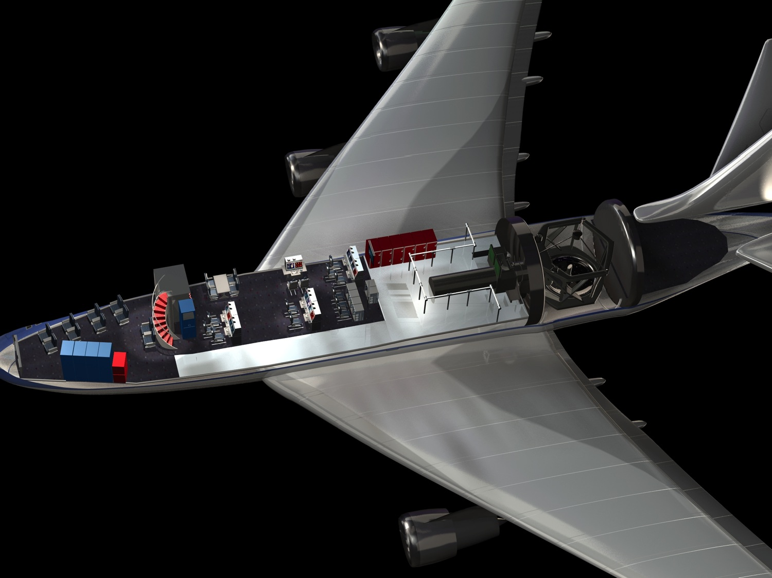

SOFIA is a highly modified Boeing 747SP
SOFIA Interior Layout
Science crew stations
Telescope
Main cabin
Pressure
bulkhead
Education stations
Science instrument

Slide 8
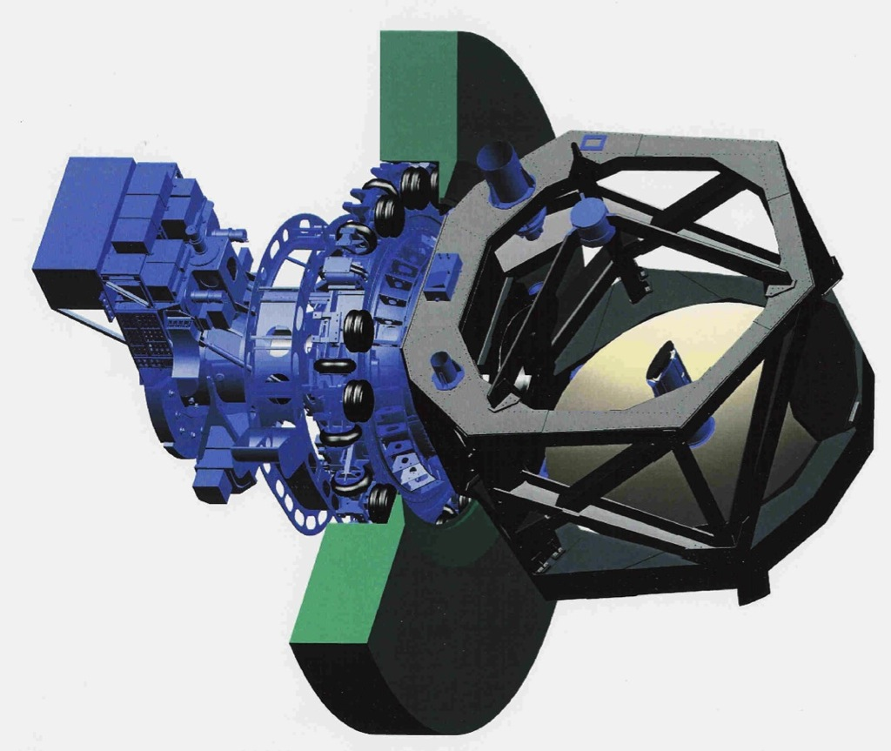
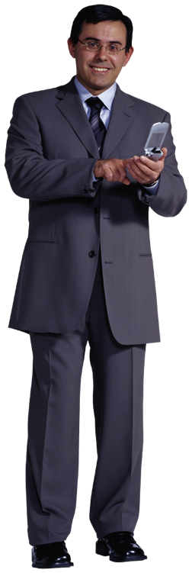
The SOFIA Telescope
The telescope is a major contribution from Germany
2.7 meter diameter mirror
Wavelength: 0.3 to 1,600 microns
Installed weight:
17 metric tons
INSTRUMENT
Forward
Aft

Slide 9
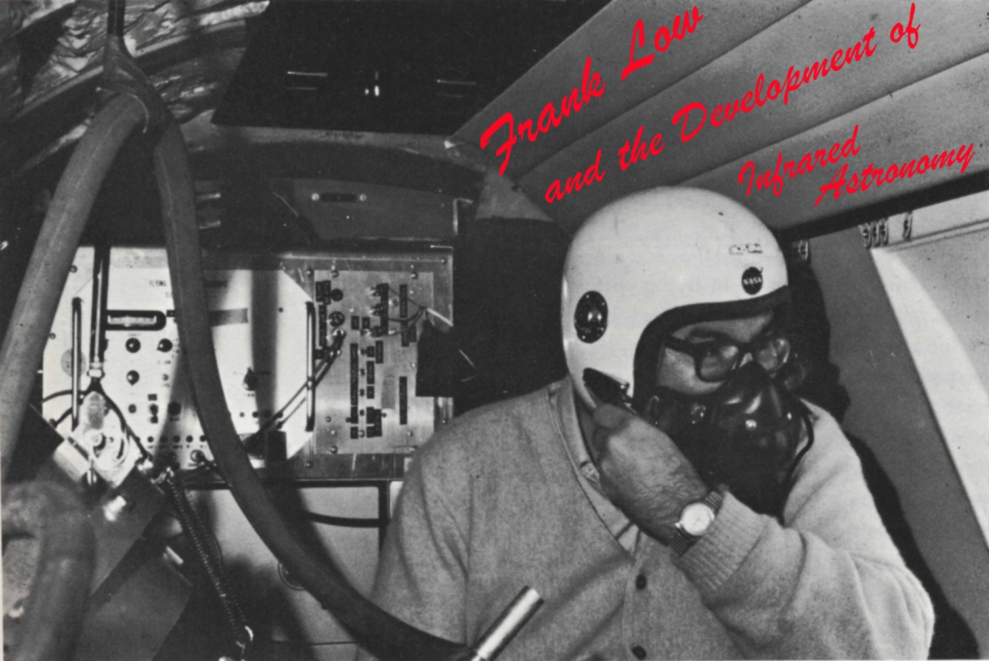
You had to be tough to be an airborne astronomer

Slide 10
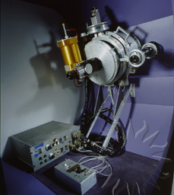
That Was Then
Frank Low’s Far-IR Photometer on Lear Jet mid-1960’s
Single-pixel germanium bolometer
2-Liter liquid helium cryostat

Slide 11
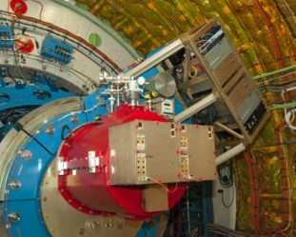
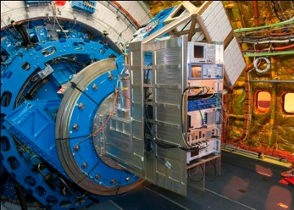
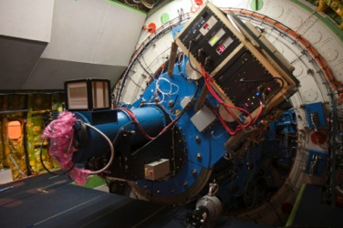
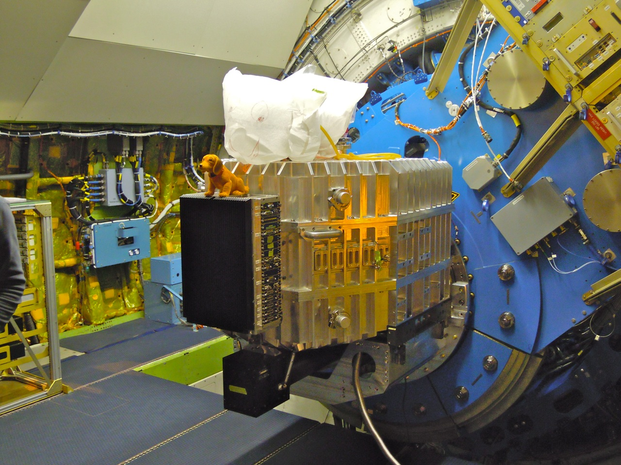
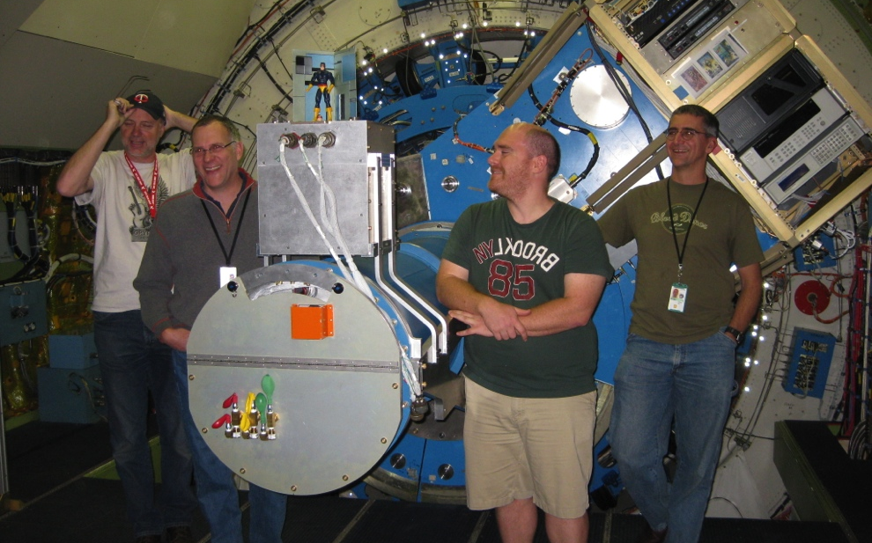
SOFIA Instrument Complement
GREAT
Heterodyne
spectrometer
FORCAST
Mid-IR Camera
FLITECAM
Near IR Camera
HIPO
Occultation Photometer
FIFI-LS
Integral Field Spectrometer
EXES
High Resolution
IR Spectrometer
And coming soon: HAWC+

Slide 12
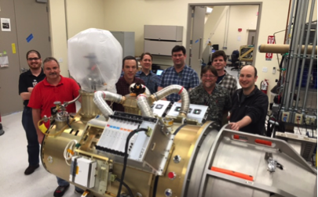
HAWC+

Slide 13
SOFIA Instrument Complement
Instrument | Description | Coverage
EXES (Echelon-Cross- Echelle Spectrograph) | High Resolution (R > 10⁵) Echelle Spectrometer | 5 – 28 μm
FIFI-LS (Field Imaging Far-Infrared Line Spectrometer) | Dual Channel Integral Field Grating Spectrometer | 42 – 110 μm 100 – 210 μm
FLITECAM (First Light Infrared Test Experiment CAMera) | Near Infrared Imaging Grism Spectroscopy | 1 – 5.5 μm
FORCAST (Faint Object infraRed CAmera for the SOFIA Telescope) | Mid-IR Dual Channel Imaging Grism Spectroscopy | 5 – 25 μm 25 – 40 μm
FPI+ (Focal Plane Imager Plus) | Visible light high speed camera | 360 – 1100 nm
GREAT, upGREAT (German REceiver for Astronomy at Terahertz frequencies) | High resolution (R>10⁶) heterodyne spectrometer; multi-pixel spectrometer | 1.25 – 1.52 THz 1.81 – 1.91 THz 4.74 THz
HAWC+ (High-resolution Airborne Wideband Camera-Plus) | Far-Infrared camera and polarimeter | Five ~20% bands at 53, 63, 89, 154, & 214 μm.

Slide 14
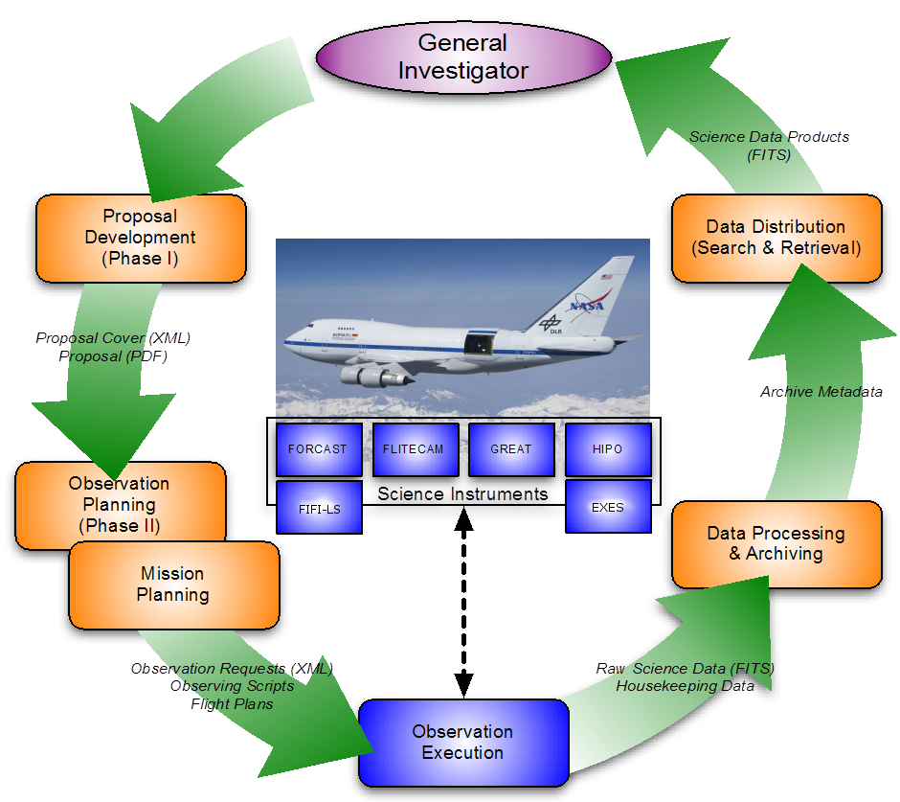
Life Cycle of a SOFIA Observation
  Issuing Call for Proposals
  User Support
  Selection of Investigators
  Observation Planning
  Observations
  Data Reduction
  Archive

Slide 15
Other Key Observational Considerations
SOFIA is a warm telescope
  Compared to Herschel and particularly Spitzer, the background from the telescope is very high
The longest observing leg is ~4 hours.
  Typical flights are 10 hours wheels up.
  4-hour limit is because the airplane needs to turn around to return to home base.
Flight planning is a complicated process of piecing together flight legs

Slide 16
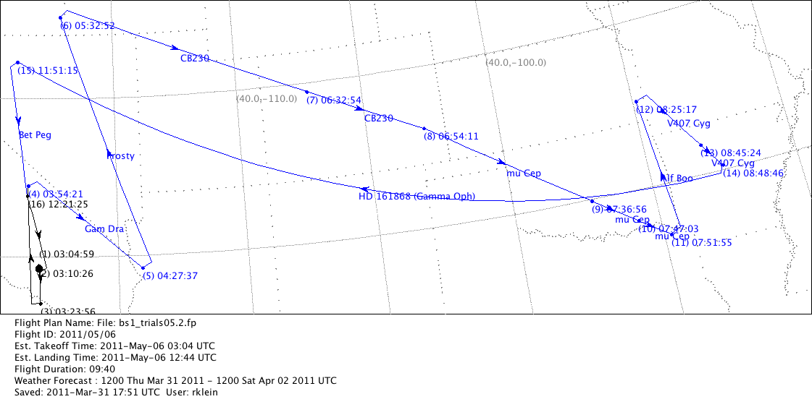
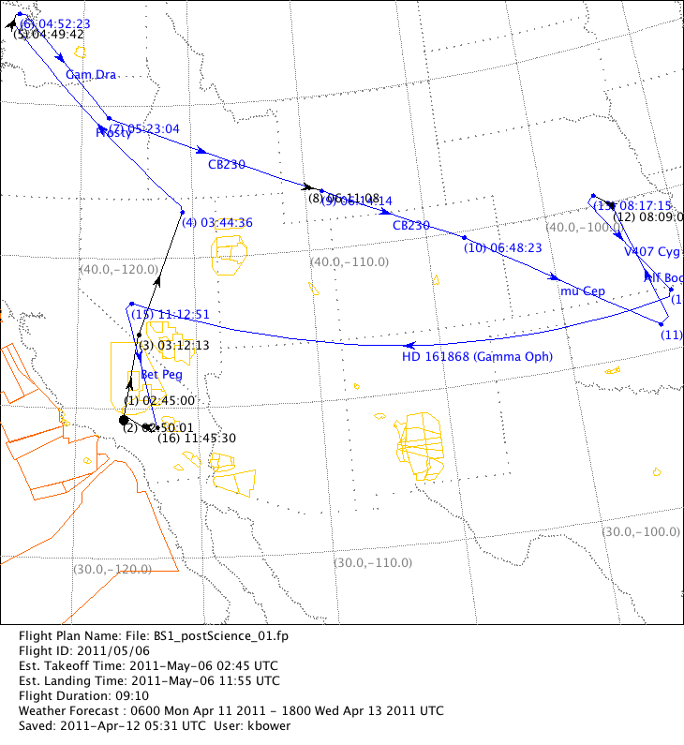
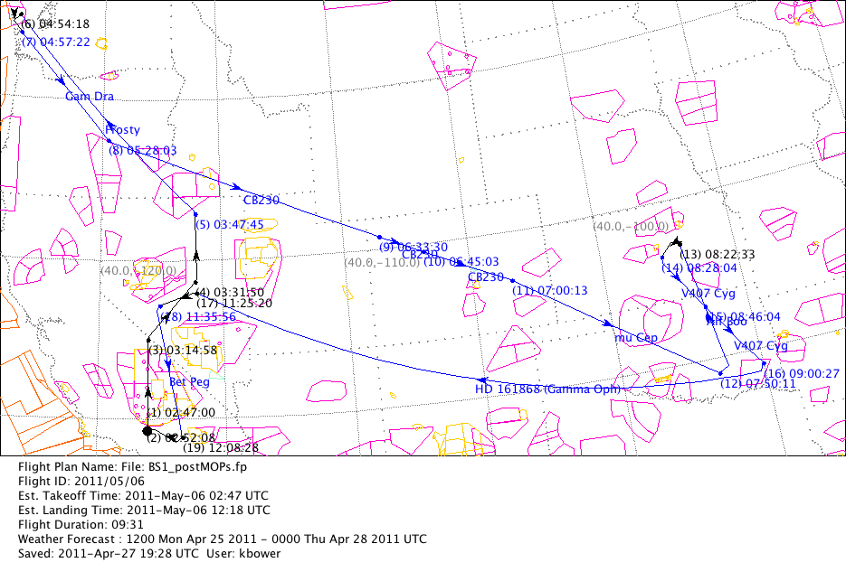
Flight Planning − A jig saw puzzle with changing tiles
Flight Plan: Basic Science 1 flight #1
Planned for 5/5/11
The top panel shows a draft version of the plan, which was too long.
The plan shortened.
When the pilots reviewed the plans, they indicated additional problematic airspaces.
A set-up leg needs to be added.
The orange and yellow areas (SUAs) are off-limits except Edwards.
Mexican air space is off-limits

Slide 17
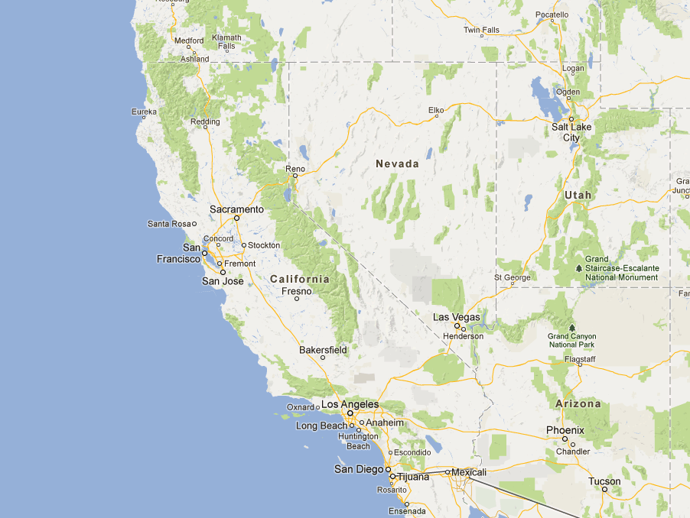
SOFIA Science and Operations Centers
SOFIA Science Center
NASA Ames Research Center
SOFIA Operations Center
NASA Armstrong Flight Research Center

Slide 18
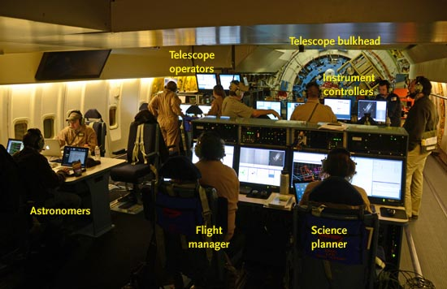
Mission Operations Crew

Slide 19
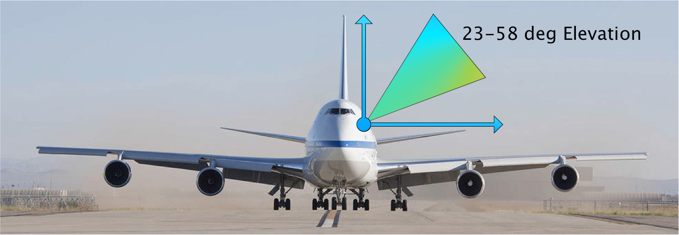
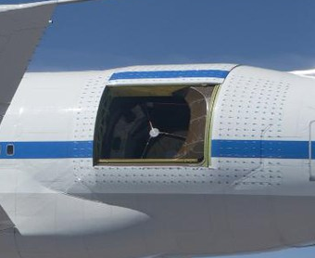
Telescope Observing Limits
20 – 60 Degree Elevation
Azimuth Range +/- 3 Degrees

Slide 20
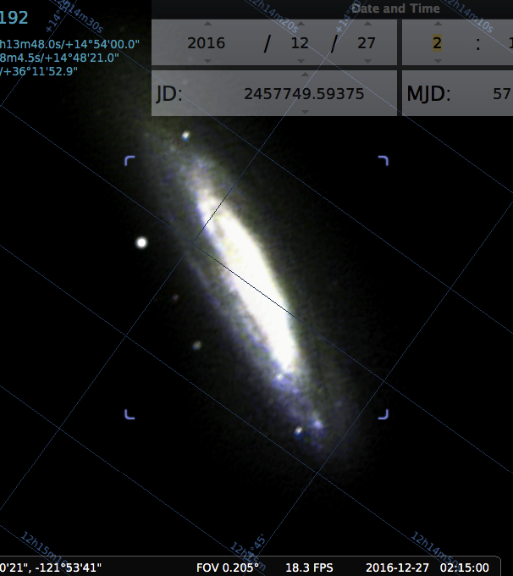
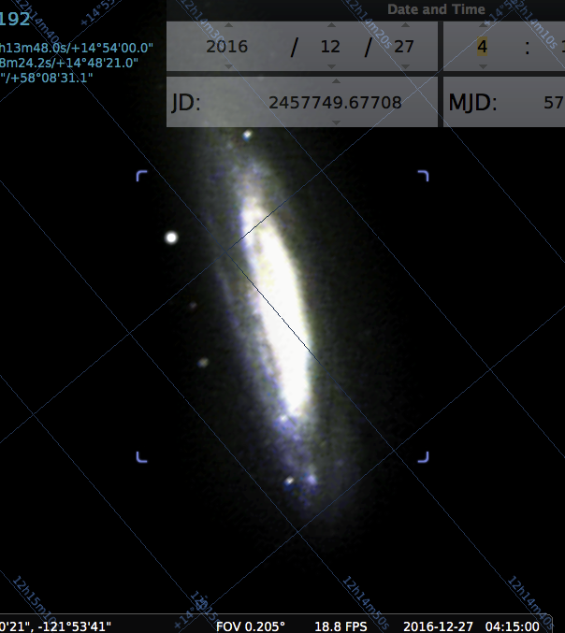
Line of Sight Rewinds
As an Alt-Azimuth telescope, the field will rotate for objects being tracked by SOFIA
Speed of field rotation depends on location in sky
Unlike a pure Alt-Az telescope, SOFIA has limited capability rotate about optical axis to compensate for this rotation
Range is ~ 6 degrees
Before limit is hit, we execute a Line of Sight Rewind

Slide 21
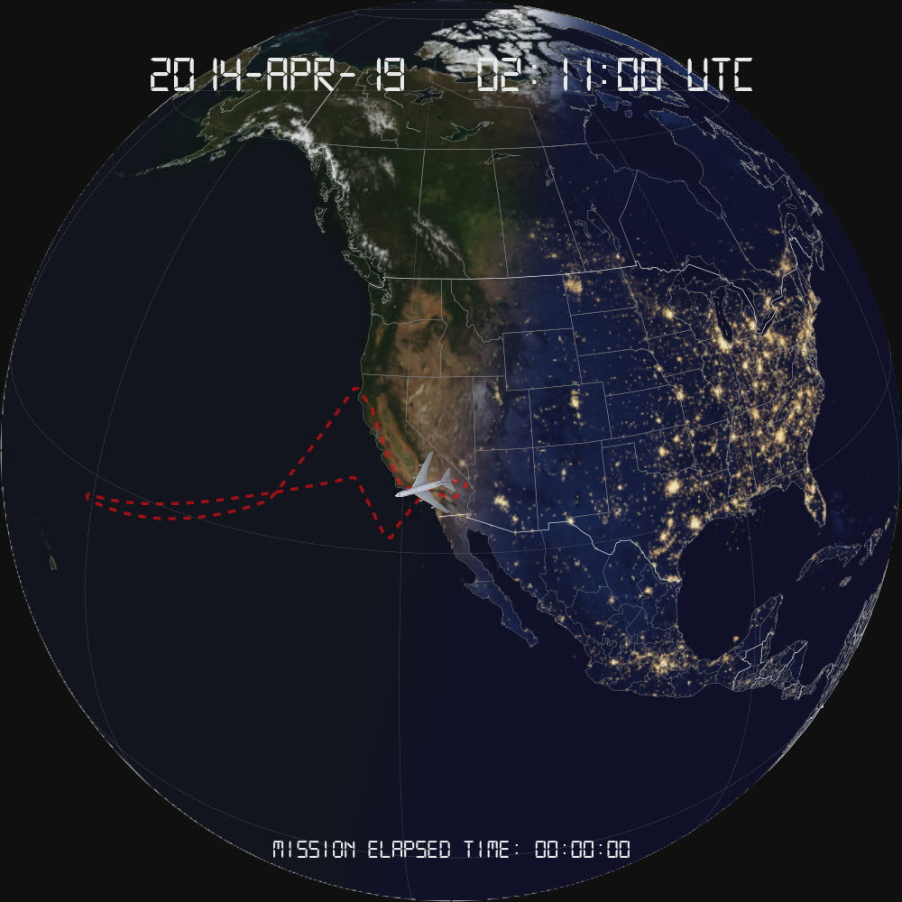
Typical SOFIA Flight

Slide 22
SOFIA Cycle 5 Call for Proposals
Cycle 5 period: 1 February 2017 – 31 January 2018
104 Science Flights
  560 Hours
Southern Hemisphere Deployment in June-July 2017
  Two instrument baseline
Available US funding: $5 M

Slide 23
Timeline
Call issued: April 29, 2016
Call update: June 10, 2016
Proposal deadline: July 1, 2016
US TAC: late Aug 2016
German TAC: early September 2016
Selection announced: October 1, 2016
Nominal Cycle 4 observing period:
1 Feb 2017 – 31 January 2018.

Slide 24
Infrared Mission Coverage

Slide 25
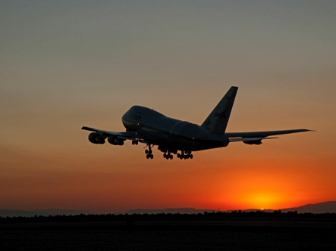
http://www.sofia.usra.edu

