Slide 1
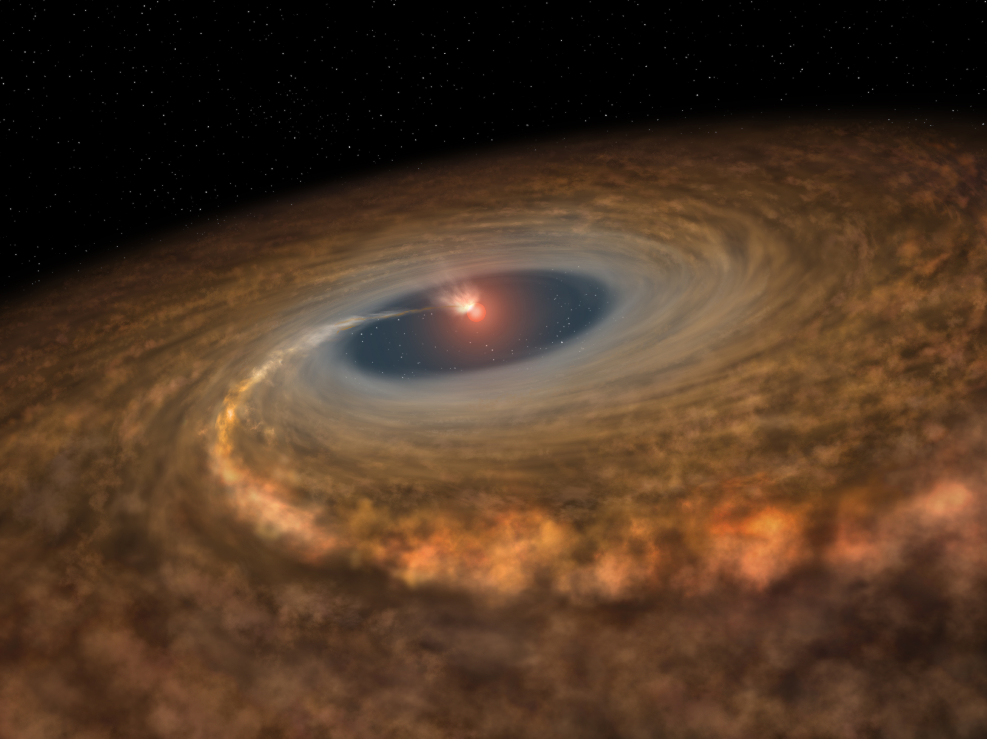


Episodic Accretion in Massive Star Formation
SOFIA/FIFI-LS observed maser flaring due to an accretion burst in a massive protostar located approximately 22,000 light-years away in the constellation of Ophiuchus.
Because the radiation generated from an accretion event emerges mainly in the mid- and far-infrared, SOFIA data are crucial for deriving the total luminosity of the young star and the fundamental parameters of the accretion burst.
The results support the predictions of disk fragmentation models while ruling out alternatives like stellar mergers. ​They also confirm that the formation of high-mass stars can be considered a scaled-up version of the process by which low-mass stars like our Sun are born.
Paper: “Infrared observations of the flaring maser source G358.93-0.03. SOFIA confirms an accretion burst from a massive young stellar object”
Stecklum, B., et al., 2021/02, A&A, 646A, A161.
Image credit: Lynette Cook
Notes:
Paper DOI: http://doi.org/10.1051/0004-6361/202039645
High-res image link: https://www.sofia.usra.edu/sites/default/files/Public/SCI2021_009.jpg
Science Spotlight: https://www.sofia.usra.edu/multimedia/science-results-archive/episodic-accretion-massive-star-formation

Slide 2
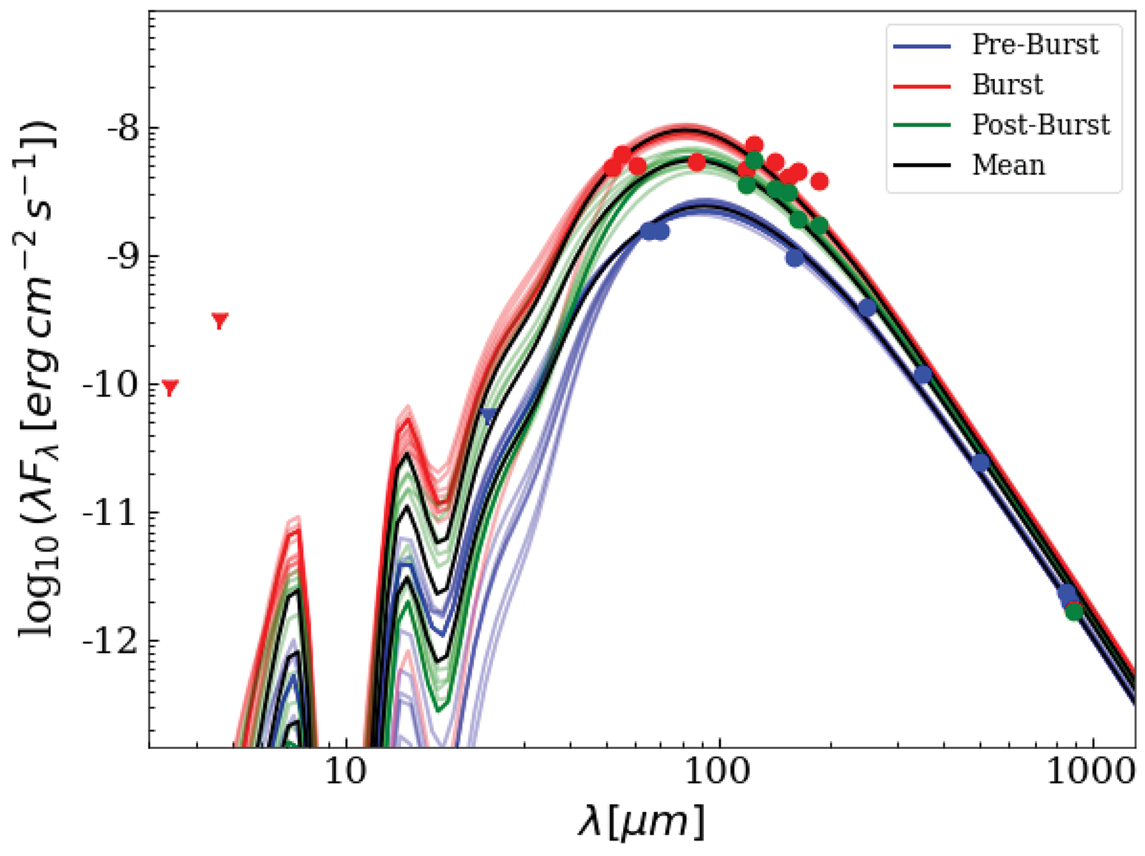
Episodic Accretion in Massive Star Formation
Strength of the radiation of the young massive star G358 as a function of the wavelength. Dots mark measured values from FIFI-LS/SOFIA (red & green) and PACS/Herschel satellite (blue) and lines the modeled emission of the object. The colors mark points in time, with blue meaning before the stochastic accretion event, red during (SOFIA flight 1) and green, 18 months after (SOFIA flight 2).
Image credit: Stecklum et al. 2021
Notes:
High-res image link: https://www.sofia.usra.edu/sites/default/files/Public/SCI2021_008.png

