Slide 1
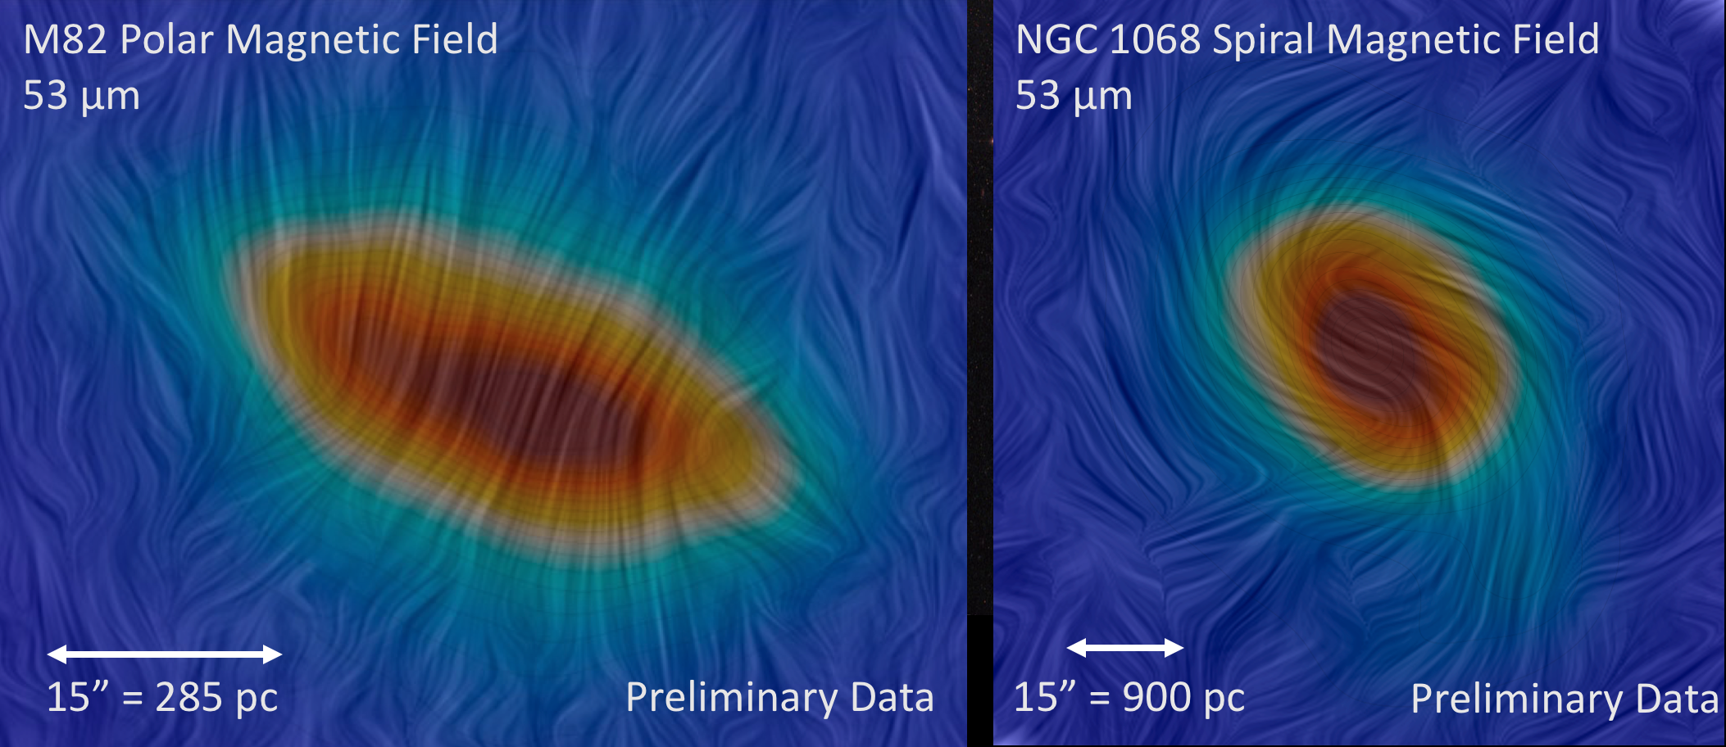
Starburst Galaxies vs Active Galactic Nuclei
Polarization Observations of Active Galaxies
Lopez-Rodriguez, E., et al., in prep
Instrument: HAWC+, 53–89 μm
Background
In the far-infrared, the emission of aligned dust grains is intrinsically polarized. Polarized emission traces ordered magnetic fields, which can potentially imply an ancient galactic magnetic field. Magnetic field can affect the gas flows in galaxies around bars and halos, which contribute significantly to the total pressure balancing the interstellar medium against gravity. When massive star formation (starburst) occurs in a galaxy, it can play an important role in the evolution of galaxies at all ages.
Determining the configuration of the magnetic field in galaxies will explain how galactic magnetic fields are generated, maintained, and how they will likely evolve. Ascertaining the role of dust grain alignment in the outflow of starbursts will reveal the role of magnetic fields in star formation at galactic scales.
Starburst Galaxy
Dusty galactic outflows
driven by star formation
Active Galactic Nuclei
Magnetic arms due to polarized emission from aligned dust grains
Background image: M82: Galaxy with a Supergalactic Wind
Image Credit: NASA/ESA/The Hubble HeritageTeam, (STScI/AURA)

